Slide 1

Youth to Adult Transition Program
San Mateo County Behavioral Health and Recovery Services
Jason Kimbrough, LMFT
Unit Supervisor

Slide 2

“Too Old, Too Young” - 1993 report commissioned by the Zellerbach Foundation
“youth aged 18-22 are falling between the cracks of the child and adult mental health systems; and this is a time when they need even more help than before “

Slide 3
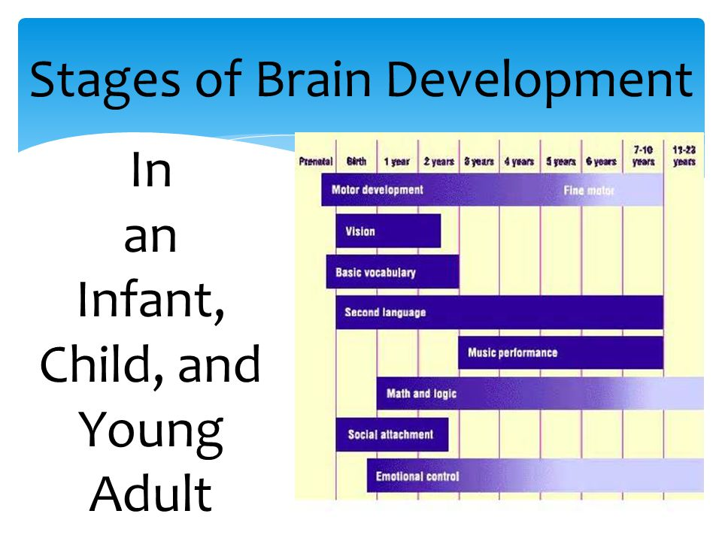
Transitional Age Youth
17-25 Years of Age

Slide 4
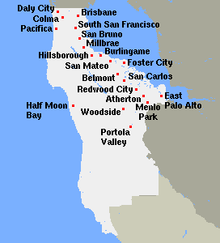
County-Wide Specialty Program
Youth to Adult Transition team serves approximately 300-350 TAY per year

Slide 5
Youth to Adult Transition Program Facts
- Program often referred to as “YTAC” which stands for Youth Transition Assessment Committee (committee established in 1992, prior to the formation of the actual program, to ensure the review and transition of youth to the adult system of care). Committee members included various providers/supervisors, contractors, community providers, and stakeholders
First “Transitional Clinician/Case Manager” established part-time in 1993 (Linda Simonsen, LCSW)
Additional program expansion 1994-1998; and the program name became synonymous with “YTAC”
Significant program expansions from 2014 to present thanks to Measure A and MHSA funding

Slide 6
Services Offered by the BHRS Youth to Adult Transition Program
Intensive Clinical Case Management: any combination of Clinical Assessment, Treatment Planning, Care Coordination, Individual/Family/Group Therapy, Targeted Case Management, Linkage, Assertive Community Treatment, and Consultation
Face-to-Face contact with 18-22 year olds admitted to SMMC Psychiatric Emergency Services ( 7 days per week/ 9:30am – 6:30pm); and subsequent linkage and/or follow-up care
Caseload sizes ranging 20-25 clients per clinician to ensure focused and intensive clinical care (research indicates approximately 15-20 clients per clinician as ideal)
Peer and Family/Caregiver support by Peer Support Workers with Lived Experience (positions funded for First Episode Psychosis support/services)
Socialization Groups and Outings (funded by MHSA grant)

Slide 7
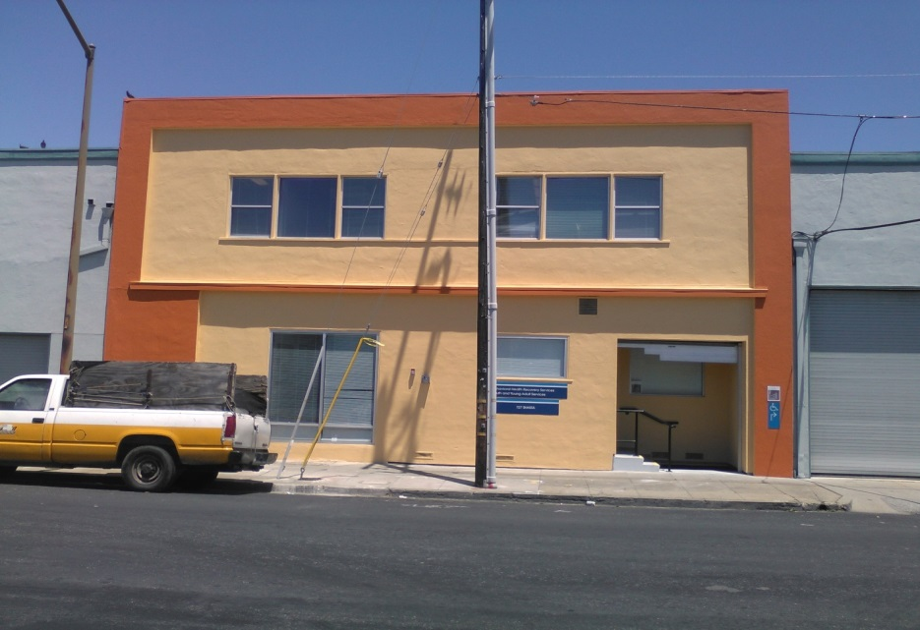
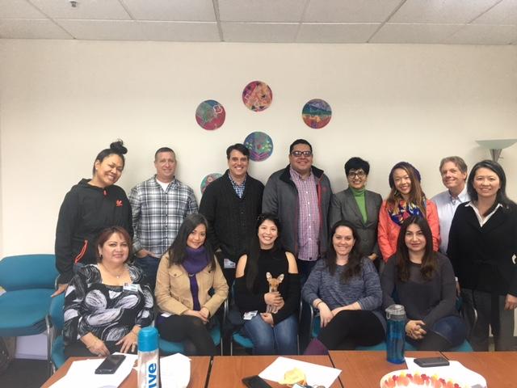
Shasta Youth and Young Adult Clinic
727 Shasta Street
Redwood City, CA 94063
599-1033 Fax 368-4001

Slide 8

YTAC Program Staff
Jason Kimbrough, LMFT Unit Supervisor
Rosario Lopez, Admin/Med Office Support
Sonia Dham, Family Partner
Repeka (“Bexx”) To’omalati, Peer Partner
Meliza Sandoval, LMFT Clinical Case Manager
Aaron Gonzalez, MFTI Clinical Case Manager
Natalie Breen, LCSW Clinical Case Manager
Gustavo Beltran, LCSW Clinical Case Manager
Sharzad Kaviani, LMFT Clinical Case Manager
Glencora King, MFTI Clinical Case Manager
Mark Mosely, AOD Case Manager/Assessment Specialist
Maria Tan, Occupational Therapist
Dr. Patti Lee, MD Psychiatrist
Dr. Rashmi Garg, MD Psychiatrist

Slide 9

BHRS Youth to Adult
Age 17-25 years
Resident of San Mateo County
Meet SMI criteria
Willing to participate in services
Receives Medi-Cal or is Medi-Cal Eligible

Slide 10

Sources
Psychiatric Emergency Department
Inpatient Hospitals
Youth System of Care: Therapeutic Day Schools, School Based Mental Health, Regional Youth Clinics, Youth Services Center, Youth Case Management, Probation, School Districts, Residential Placements, Edgewood Programs, Youth Service Bureaus, BHRS Call Center, Primary Care, and others
Children and Family Services/CPS
Adult System of Care: Regional Adult Clinics, Interface, Med/Psych Clinic, Adult Resource Management, BHRS Call Center, Assisted Outpatient Treatment, Edgewood TAY FSP, PREP/BEAM, Correctional Mental Health, Service Connect, Pathways, and others

Slide 11

San Mateo County TAY System of Care
Private Provider Network/BHRS Call Center
Interface/Med Psych Clinic
Regional BHRS Clinics
Youth Transition Assessment Committee (Core TAY Stakeholders)
YOUTH TO ADULT TRANSITION PROGRAM
EDGEWOOD TAY FULL SERVICE PARTNERSHIP
MENTAL HEALTH ASSOCIATION/SAYAT PROGRAM
CAMINAR YAIL PROGRAM CAMINAR SUPPORTED EDUCATION (CSM and Skyline)
STAR VISTA TAY SERVICES
Human Service Agency Children and Family Services
BHRS Adult Resource Management
Full Service Partnerships
Caminar: Redwood House, Eucalyptus House, Hawthorne House
Inpatient/PES
Cordilleras (locked)
* Several additional BHRS programs/providers, contractors, and community providers offer TAY services as well

Slide 12
Referring for TAY Mental Health Services
Complete the TAY referral form and e-mail or fax to Jason Kimbrough, MFT
The TAY referral form is accepted by all core TAY providers (YTAC, TAY FSP, YAIL, SAYAT, PREP/BEAM)
Referring person will be contacted to schedule a presentation to the YTAC Committee. The meeting is held on the 1st and 3rd Thursdays of the month, from 1:30-3:30pm, at Central County BHRS – 2nd Floor Conference Room (1950 Alameda De Las Pulgas in San Mateo)
Direct referrals (not requiring a YTAC presentation) may also be considered on a case-by-case basis

Slide 13
TAY Full Service Partnership
Edgewood
Contract with BHRS to provide intensive, Assertive Community Treatment (Wrap-Around Model) to a maximum of 50 BHRS TAY clients
Eligibility determined through the YTAC committee, or by close review and consideration by key TAY Managers, Supervisors, and Stakeholders
TAY ages 17-25 and resident of San Mateo County
Meets criteria for SMI
Willing to participate in the program
+ 2 or more of the following: Multiple PES visits in the last two years; Multiple inpatient hospitalizations with extended visits in the last two years; Co-occurring Disorder (alcohol/substance, cognitive impairments, physical health); Homeless or currently at risk of homelessness; Exiting School-Based IEP/Mental Health Services; Stepping down from a higher level of care (residential, IMD, Jail, YSC); AB 12/non-minor dependent

Slide 14
Contact
FOR TAY REFERRAL FORM, QUESTIONS, and CONSULTATION
JASON KIMBROUGH @ 599-1071
FAX 368-4001
JKIMBROUGH@SMCGOV.ORG

