Slide 1
Q3 QI/QA Subcommittee Meeting
Healthcare for Homeless & Farmworker Health Program
Thursday October 10th, 2024
Notes:
- Take roll call

Slide 2

Approve Meeting Minutes from Q2 2024
Notes:
Do I hear a motion to approve the Q1 2024 meeting minutes?
1st
2nd
All in favor

Slide 3
Agenda
Program Updates
Q2 2024- Performance Measures
Looking Ahead: 2024
QI/QA Plan Amendment
2023 UDS Rankings

Slide 4
QI/QA Plan Amendment
Update calendar timeline
Updating HRSA 2024 definitions
Healthy People 2030- updated target goals
Removed Adult BMI measure to align with SMMC reporting
Notes:
Go over main points that will be changing from QI plan
If there’s any thoughts you have on the plan, changes, ideas we can discuss them now
I will update the plan and share final draft with you at the next meeting
EPIC implementation: UDS reporting will look different- pulling info from two databases

Slide 5
Program Updates
  Cervical Cancer Screening Reporting
  HCH/FH is working with the BI team to determine if/where falloff is happening with cervical cancer screenings
  HCH/FH definition being compared to QIP definition and patient empanelment
  Depression Remission at 12 Months: Follow-Up
  How is remission tested? Is there a positive test done?
  Denominator:
    Patient with a score of 9+ on PHQ-9 one year before measurement period
  Numerator:
    Patient who received a PHQ-9 score of <5 by most recent 12 month visit(+/- 60 days)
  Note: PHQ-9 is the only screening tool that can be used for this measure
Notes:
Cervical Cancer Screening Reporting
BI is highly focused on EPIC implementation so they haven’t been able to get to this request, but its on their radar
My goal if they can’t modify this for our last report of the year (Q3) is to for sure have this validated by our annual data reporting in January
Depression Remission at 12 Months
This isn’t a high priority measure but I still want to clarify any questions you had about how this data is collected

Slide 6
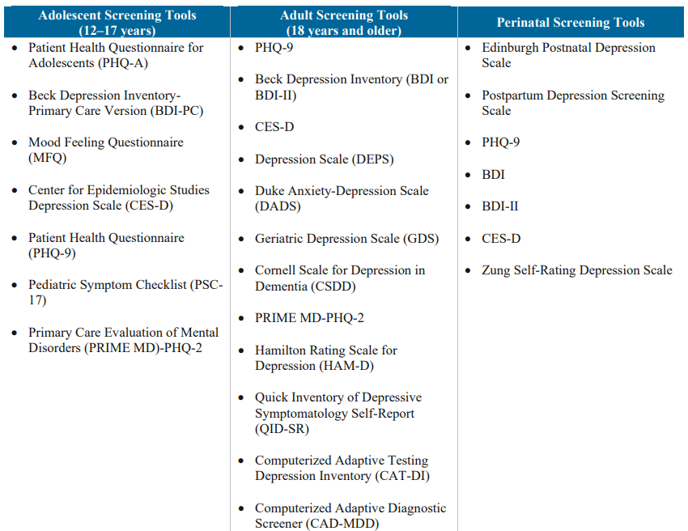




Program Updates
  Depression Screening and Follow Up: Update
  Specific screening tool is required?
  Standardized and validated depression screening tool required for this measure. Examples include but are not limited to chart
  PHPP Discussion
    Screening tools used
    New staff members added to teams (ex. HEAL clinicians and psychiatrists)
    Plans to improve screening measure
Notes:
In our last meeting, there were some questions about how dep screen was collected and what tools were used

Slide 7
Q2 2024- Performance Measures
Notes:
UDS Reporting
This is one of the requirements that we have as a program: submit our annual uds submission.
UDS: Uniform Data System
We start preparing for this several months in advance, and consists of several parts. Demo characteristics. Financial, operation, and performance quality indicators. We put this report together by splitting up the work. Jim does financial. Gozel does demo. I will work on QI performance.
Today I'm going to review those qi metrics. There's a total of 20ish metrics we report on and out of those, and we select several of them than we concentrate on throughout the year to improve the results and these are those.
- The UDS is reported on a universal basic, doesn’t divide by peh and fw, we report on everybody as a whole.
If they say uds report is put together from county patients, but we also combine contractor data. For quality measures, these are only smmc county patients bc there's no way for us to know screenings info or medical records from partner data. They only sent us demo data. So we take the ppl they're reporting and we report that in our demo data section.
Every year the UDS provides small updates or changes that they want to see in their reporting for the following year. This year, there are some changes in the reporting of race/ethnicity categories

Slide 8
Improvement in almost all outcome measures; 10% increase in FW Colorectal Cancer Screening
QIP
Notes:
Colorectal Cancer: Fit kit mail outs to HPSM assigned members- should include ACE pop which now qualify for Medi-cal, so these kits should be reaching FWs
Something to note: most improvement work at SMMC has stalled with EPIC go-live coming on soon
All staff receiving training and prioritizing implementation
An idea: long term goal is to re-think how metrics are approached. Have improvement councils take the lead on certain metrics to drive improvement, receive support from Pop Health and BI team
In general more collaboration between analysts and diff programs so depts feel less siloed with their work
Goal is to start this work after EPIC go live

Slide 9
Performance Measures
Significant improvement in Depression Screenings for both PEH and FWs from Q1 to Q2
Notes:
Hypertension: HPSM will be doing bulk purchase of bp cuffs for med center for HPSM members
Depression Scrn: I was working with the DEI manager to prioritize PEH/FWs for depression screening over the phone using MSW patients
This project is put on hold as the DEI manager transitions into a new role
I’d like to meet with the new manager to figure out their interest in picking this project back up and a timeline

Slide 10
2023 UDS Rankings- CA 330 Programs
Metric | 2022 | 2023 | Positive/Negative Change
Cervical Cancer Screening | 58% | 59% | Positive
Colorectal Cancer Screening | 42% | 42% | No Change
Breast Cancer Screening | 52% | 55% | Positive
Depression Screening & Follow-Up | 67% | 67% | No Change
Adult BMI & Follow-Up | 59% | 65% | Positive
Hypertension | 61% | 64% | Positive
Trimester entry into Care (1st trimester) | 76% | 77% | Positive
Diabetes A1c > 9% or missing | 33% | 29% | Positive

Slide 11
2023 UDS Rankings- Adjusted Quartile Ranking
Metric | 2022 Adjusted Quartile Ranking | 2023 Adjusted Quartile Ranking | Positive/Negative Change
Early Entry into Prenatal Care (1st Trimester) | 1 | 3 | Negative
Cervical Cancer Screening | 4 | 3 | Positive
Adult BMI and Follow Up | 4 | 3 | Positive
Diabetes A1c > 9% or missing | 1 | 2 | Negative
Notes:
The measures that are not included here are because there was no change in their ranking
I know we’re no longer tracking Adult BMI but since it was a part of last years reporting I did want ot

Slide 12
Looking Ahead: 2024
Implementing new QI/QA Plan, will discuss what that looks like in next meeting
Review ongoing QI projects
Review Patient Satisfaction Survey and Patient Grievance data
Next QI/QA Subcommittee meeting: December 2024

