Slide 1
Intranasal Narcan for Law Enforcement
San Mateo County Emergency Medical Services
in conjunction with Menlo Park Police Department
Notes:
Special thanks to Jonathan Baxter who worked with the EMS Medical Director and the Local EMS agency to help create and provide you this content.
Covered through the following Authority: California Health and Safety Code‐ Division2.5:EmergencyMedicalServices[1797.‐ 1799.207.] California Code of Regulations, Title 22. Social Security, Division 9. Ch. 1.5 Prehospital Emergency Medical Services

Slide 2
Objectives
Identify common causative agents
Identify pertinent assessment findings before and after administration
Recognize need for personal safety equipment and scene awareness
Profile of naloxone including:
Indications
Contraindications
Side/adverse effects
Administration
Dosages
Mechanisms of drug action
Medical asepsis
Disposal of contaminated items and sharps

Slide 3
Common Causative Agents
Opiates
Heroin
Fentanyl
Codeine
Methadone
Percocet
Oxycodone
Dilaudid
Demerol

Slide 4
Things to know about Narcan
Narcan does NOT reverse ODs caused by non-opioid drugs, such as cocaine, benzodiazepines (e.g., Xanax, Klonopin and Valium), methamphetamines, or alcohol.
Narcan administered to a person dependent on opioids may produce withdrawal symptoms.
Withdrawal, although uncomfortable, is not usually life-threatening

Slide 5
Things to know about Narcan
Strongly recommended that anyone receiving Narcan be transported to the hospital by EMS
With some long-lasting opioids, Narcan may wear off before the opioids, causing the person to lose consciousness again
Highly recommended to use officer judgement to restrain individual
Notes:
Teaching point: 1) Once a patient regains conscious, if they are alert and oriented, you can’t force them to do things against their will.
2) Officer is in a vulnerable position when administering Narcan and the effect is rapid, individual can become violet and officer not have time to react.

Slide 6
Signs & Symptoms that heighten concern
Noticeable elation/euphoria.
Marked sedation/drowsiness.
Confusion.
Intermittent nodding off, or loss of consciousness.
If sufficiently severe, hypertension and pupillary dilation may be present because of CNS hypoxia
Constipation.
Notes:
EMS: Those highlighted are the most important signs in opiate overdose.. Move to the top

Slide 7
Signs of Serious Opioid Overdose
Breathing slow and shallow (less than 10 breaths per minute which equals 1 breath every 6 seconds) or has stopped
Blue or grayish lips and fingernails
Skin may turn gray, blue
An overall blue or grayish appearance
Pulse (heartbeat) is slow, erratic, or not present
Constricted Pupils
Notes:
Teaching Point: Ask what should the officer be getting ready to do? ANS: CPR/BVM – this will provide time to confirm opiate overdose as the CPR/BVM will keep them alive.
These are all items that should be taught in annual POST training

Slide 8
Constricted Pupil
Look for pupils <3mm
1mm = about the width of the side of a dime

Slide 9
Signs of Opioid Overdose
By themselves, most previously listed signs are not reason enough to administer Narcan
Must be a reason to suspect opioid overdose in conjunction with the signs listed
Narcan indicated only when opioid OD suspected, AND the victim is unconscious

Slide 10
Reasons to suspect opiod overdose
When informed by the dispatcher that a given person appears to be suffering an opioid overdose
Opioid drugs found on scene
Opioid drug paraphernalia found on scene (needles, syringes, chore boy, a burnt or charred spoon)
Witnesses state victim was taking some sort of opioid prior to OD
Known heroin user location

Slide 11
Paraphernalia commonly found on scene of overdose

Slide 12
Considerations responding to Overdose
Scene safety is your #1 priority
Stay aware of surroundings during victim evaluation, setup, and administration of Narcan especially if by yourself
You may lose tactical advantage quickly due to most victims being on the ground and in close quarters with awkward access to the victim and difficult egress from the victim etc.
You will generally be in a crouched or kneeling position with your hands full if an outside influence engages you, or your victim turns violent during the treatment
If alone, request backup prior to administration of Narcan due to potential for violence from victim. OD victims do not react the same, the unpredictable nature of the victims requires intense situational awareness at all times
Notes:
Teaching Points: Review individual agency response protocol and consider a 2 officer response to these type of calls.

Slide 13
Personal Safety
Body substance isolation with use of personal protective equipment
Be aware that IV drug users may be carrying unsafe sharps
Narcotic patches may transfer medication to your skin if exposed for an extended period of time
Heat and moisture also increase transfer
Exercise caution while engaged in physical contact
Notes:
RECOMMENDATION: Consider N95/mask and eyewear protection to prevent exposure from bodily fluids (BSI exposure)
TEACHING POINT: Patches would be difficult to overdose on as the delivery is slow.

Slide 14
Naloxone

Slide 15
Naloxone: Action
Drugs that block or reduce the action of another drug are called antagonists.
Naloxone is a opioid antagonist
“Antagonizes effects of opiate narcotic agents by competing at the receptor site resulting in reversal of respiratory depression associated with opiate overdoses.”
Half-life of Narcan is shorter than opiates and symptoms can recur.

Slide 16
Side Effects
Patient may become agitated or violent after drug is administered.
Consider restraining individual prior
Rapid administration may cause vomiting.
Consider BSI
May precipitate withdrawal in chronic narcotic users.
Notes:
Some departments handcuff before administration.
TEACHING POINT: BSI=Body Substance Isolation (gloves, mask, eye protection)

Slide 17
When to Use Naloxone
Check responsiveness
Check breathing status
Remember: Check & Manage ABCs!
Notes:
TEACHING POINT: ABCs (Airway, Breathing, Circulation) will buy you more time. Low respiratory rate is what kills these patients. Bag valve mask can buy you time until you’re able to administer the drug.

Slide 18
Intra-Nasal Naloxone

Slide 19
NASAL SPRAY

Slide 20
Pre-Manufactured Kit Click image for video
Notes:
TEACHING POINT: Click on one photo or the other will take you to internet to watch video. INTERNET CONNECTION REQUIRED

Slide 21
How to Prep Intra-nasal Naloxone

Slide 22
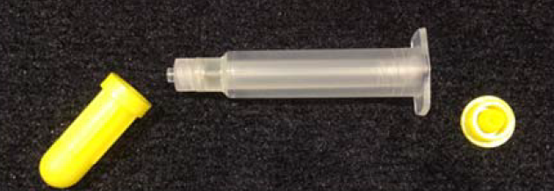
Remove caps from injector

Slide 23
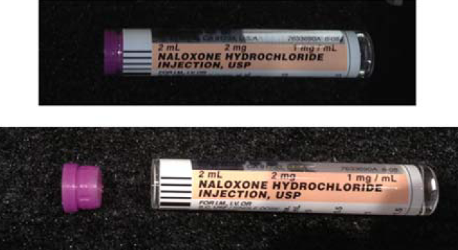
Remove cap from medication vial

Slide 24
Get atomizer/MAD

Slide 25
Attach atomizer/MAD to injector

Slide 26
Screw medication vial onto injector

Slide 27
How to Use Intra-nasal Naloxone

Slide 28
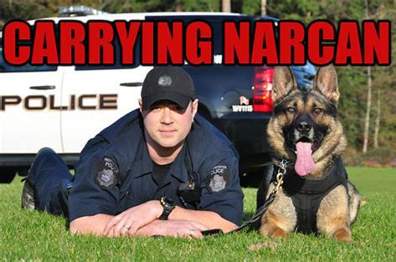
NARCAN FOR POLICE K9
PINCH ONE NOSTRIL
ADMINISTER SPRAY IN ONE NOSTRIL
NOTIFY ON SITE SUPERVISOR OF EXPOSURE AND LOCATION OF SUBSTANCE
TAKE TO VETERINARIAN IMMEDIATELY
IF NEEDED, PROVIDE RESPIRATORY CARE WITH YOUR PROVIDED WAG CANINE BVM
Notes:
TEACHING POINTS: Same teaching points apply to K9 that apply to humans. Humans and K9s react similarly and teaching for either should be the same. Narcan use before symptom onset can be dangerous as it may block symptoms and you won’t know if true exposure occurred. While preventative administration will have no adverse effect, you will now be without your Narcan if you need it later. If you suspect your K9 has been exposed to a Narcotic, the K9 should be seen by a veterinarian regardless of the use of Narcan.

Slide 29
Patient Management
Remember: naloxone is indicated for patients with suspected narcotic overdose AND respiratory depression
Make sure you manage the patient’s airway and breathing
Oxygen delivery via BVM or BVM assisted ventilation
Adjuncts can be used: OPA or NPA
Notes:
TEACHING POINT: Use adjuncts if you have them. Contact your local EMSA if you are interested in adding to your local optional scope.

Slide 30
What to expect after administering Narcan
Each victim will react differently
Most will wake up simply confused and disoriented
Side effects may include but are not limited to: rapid heart rate, nausea and vomiting, sweating, blurred vision, and opiate withdrawal
Can become combative
Use extreme caution with combative victims
Request backup and EMS prior to administration of Narcan
Most combative victims are also disoriented and confused
Will not listen to commands
Strongly recommended that anyone receiving Narcan be transported to the hospital by EMS
Notes:
TEACHING POINTS: Remember that restraint prior to administration can help against the combative patient

Slide 31
Signs of improvement
Respiratory
Breathing returns
Reverts from irregular/inadequate to normal breathing
Circulation
Pulse present and normal
Skin tone improving, paleness and bluish tint go away
Consciousness improves and victim becomes more alert

Slide 32
Scenario 1
Your partner is handling a narcotic medication patch when your partner suddenly collapses in front of you.
Your partner is unresponsive to pain, and seems to be barely breathing.
How should you manage this scenario?
Notes:
TEACHING POINT: Patches would be difficult to overdose on as the delivery is slow, this is being used to articulate different routes of exposure even though this one is unrealistic.

Slide 33
Scenario 1, cont’d
What are your priorities?
What are you assessing?
How can you determine if this is a narcotic overdose?
Does your partner have a pulse? If no, start chest compressions!
Notes:
EMS: ABCs, pinpoint pupils; found on next slide
Promote Group Discussion: Ultimately the realization should be that this is actually a cardiac arrest and that although the administration of Narcan is not harmful, ABCs, CPR, AED is what this patient really needs.

Slide 34
Scenario 1, cont’d
Always: Manage ABCs
Control airway with an adjunct if necessary
Breathe for the patient via BVM
Physical Exam
Check pulses (not present in this case)
Start CPR and activate EMS
AED (download PulsePoint application)
Apply pads and follow AED instructions

Slide 35
Scenario 1: Conclusion
Call for ALS
Check for a pulse… no pulse? Start immediate compressions! Never delay or interrupt CPR to administer naloxone
High flow oxygen via BVM
Airway adjunct if necessary
Pinpoint pupils with respiratory depression? Other scene clues suspected of narcotic exposure.
If so, intranasal Narcan
Prepare equipment in case of respiratory/ cardiac arrest
Notes:
TEACHING POINTS: This is still much more likely a cardiac arrest than narcotic overdose, place emphasis on ABCs, but investing for clues of opiate exposure is always recommended. Narcan administration in this case is not harmful, but unlikely to have any effect.

Slide 36
Scenario 2
You and your partner are dispatched to a home for a lethargic child.
The child’s mother is concerned that her 6-year-old son fell asleep in the middle of the afternoon and now won’t wake up.
The boy can be roused with painful stimuli, but falls asleep almost immediately afterward.
Mother states he weighs 45 pounds
Notes:
TEACHING POINT: In San Mateo County (and really anywhere) there should be no weight limit for administration of narcan

Slide 37
Scenario 2, cont’d
What are your priorities?
What are you assessing?
How can you determine if this is a narcotic overdose?
Notes:
TEACHING POINT: Initial dispatch call, scene safety and observations, detailed history from parents, patient’s signs symptoms, frequent reassessment as AMS (altered mental status) might deteriorate to apnea, maintain ABCs as indicated.

Slide 38
Scenario 2, cont’d
Assess ABCs.
If the child is able to manage airway and breathe adequately, minimal interventions.
Assess pupils. Are they pinpoint?
Family medical history.
Does anyone in the family have a narcotic prescription?
Notes:
TEACHING POINT: This is going to be a drug overdose on family member’s prescription medication. Ask participants to name opiate prescriptions: Codeine, Vicodin, MS Contin (Morphine), Methadone, Darvocet, Dilaudid, Fentanyl, Hydrocodone, oxycodone, Oxycontin, Tylenol #3, Tylox, Percocet, Percodan (this is on the skills checkoff sheet, so worth going over a lot),

Slide 39
Scenario 2: Conclusion
Call for ALS.
Assist breathing with a BVM if needed.
Depends on respiratory rate, rhythm, quality.
Airway adjunct if necessary.
Pinpoint pupils with respiratory depression?
Intra-nasal Narcan
Prepare equipment in case of respiratory/cardiac arrest
AED
Notes:
TEACHING POINTS: Narcan can be used on any individual with suspected opiate overdose K9 or human

Slide 40
Withdrawal
Withdrawal symptoms can mimic flu symptoms and include:
Headache.
Nausea and vomiting.
Diarrhea.
Sweating.
Fatigue.
Anxiety.
Inability to sleep.

Slide 41
You have administered intra-nasal naloxone… Now what?
MEASURE AND DOCUMENT SIGNS AND SYMPTOMS, BREATHING AND LEVEL OF CONSCIOUSNESS EVERY FIVE MINUTES UNTIL ALS ARRIVES
Request a Supervisor for Narcan use documentation.
If intra-nasal naloxone is effective additional doses can be given, if mental status decreases again.
Paramedic may be able to restock depend on agreements with EMS.
Notes:
TEACHING POINTS: Narcan administration requires completion of NARCAN USE FORM that should be submitted to the EMS Medical Director: Gregory Gilbert to his email: ghgilbert@Stanford.edu and Garrett Fahey gfahey@smcgov.org on-duty LE agency supervisor for your jurisdiction to keep on file.
REMOVE LAST BULLET: If no agreement exists, remove last bullet. “Paramedic may be able to restock depend on agreements with EMS.”

Slide 42
Conclusion
Naloxone / Narcan is an opiate antagonist that reverses opiate overdose
1
A good patient assessment reveals patients who are candidates for naloxone
2
Consider use of intra-nasal (IN) naloxone for ALOC patients with respiratory depression
3
Airway, breathing, and circulation (ABCs) are ALWAYS TOP PRIORITY when managing patients who are candidates for naloxone
4
No person will administer the department-issued intra-nasal Narcan until they have completed both the written test & competency skills sign off.
5
You are NOT authorized, nor certified, to use or possess the department-issued naloxone off-duty.
6

Slide 43
Storage/Exchange
Narcan should be kept out of direct light and at room temperature (between 68 and 77 degrees Fahrenheit)
Each department is buying their own supply of Narcan
Each officer responsible to maintain assigned kit
LEOs/LE agencies may obtain Narcan resupply from local fire department/EMS if agreement exists
Per ORC 2529.61, law enforcement agency must obtain terminal distributor of dangerous drugs license for peace officer to obtain and use Narcan
Shelf life (how long sealed vials are good to use) of Narcan is approximately two years
Law enforcement agencies in San Mateo without ability to order Narcan can contact EMS Medical Director for required documentation. Currently that is Gregory H. Gilbert, MD
ghgilbert@stanford.edu
Keep sending him emails, he will respond, he promises
Notes:
REMOVE 4th BULLET IF NO AGREEMENT EXISTS: Remove 4th bullet “LEOs/LE agencies may obtain Narcan resupply from local fire department/EMS if agreement exists”

Slide 44
Summary
Narcan is a safe and effective drug in treating opioid overdoses
May lessen lethality of opioid overdoses by getting Narcan on scene faster
#1 priority will always be scene safety and officer safety
Proper storage, maintenance, and exchange of Narcan both at a supply station and with the individual officer is very important

