Slide 1
Commission on Aging
Supporting Older Adults
in our County

Slide 2
Commission on Aging
Mission: maintain, enhance and improve the quality of life for older adults in San Mateo County
County Board of Supervisor
(Governing Board)
San Mateo County Aging and Adult Services
(Area Agency on Aging )
Commission on Aging
(Advisory Council)

Slide 3
CoA: Review and approval of the Area Plan
2023-24 OAA funds: $4,383,760
$2,922,354 = 67% for meals
Over 60: 201,581 people
= 26.4 % of the population
Living in poverty*: 15,035
people over 60
*less than $14,580/year in 2023 for a single person
$15 for each person over 60 for meals
$7 per older adult for everything else*
*adult day health care, transportation, information and assistance, legal assistance, Ombudsman program, disease prevention, and family care giver program.

Slide 4
CoA: Advisor and Advocate
OAA: CoA must carry out
“advisory functions which further the area agency’s mission of developing and coordinating community-based systems of services for all older individuals and family and older relative caregivers specific to each planning and service area.”
45 CFR § 1321.63(a)
OCA: CoA is the
“principal advocate body on behalf of older individuals within a planning and service area”
Cal. Welf. and Inst. Code § 9402

Slide 5
Advisor: development and coordination of community-based systems of services
  20 cities
  and many non-profits provide services for older adults in San Mateo County
CoA gathers and disseminates information
  On-demand transportation for seniors
  Core Service Agencies
Commissioners develop relationships
  Senior Centers and Programs, Senior Advisory Boards

Slide 6
Advocate: Provision of resources for older adults
More funding for programs and services for older adults
  Measure K funding for Families, Children and Seniors
More transportation options
  Transportation for Veterans’ Home in Colma
More information about services and programs
  Help at Home guide update and distribution
  Meeting public at events for older adults

Slide 7
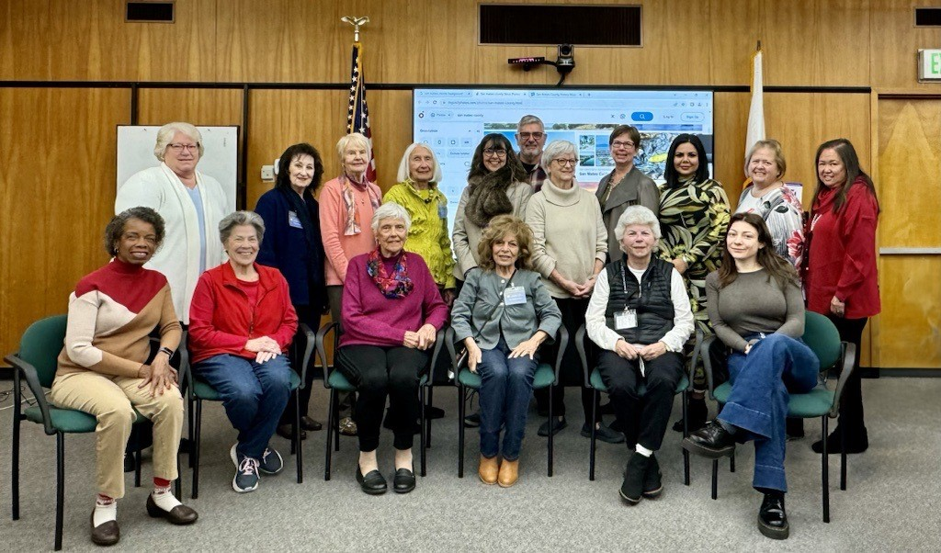

Slide 8
Successful Aging in Place
Addressing the Loneliness Crisis
Information
and
Resources
Social Isolation
and
Transportation
Aging Readiness
and
Family Caregiver Support

Slide 9
THANK YOU FOR YOUR SUPPORT OF OLDER ADULTS IN OUR COMMUNITY

