Slide 1
Commission on Aging
Annual Report
2023-24

Slide 2
55 years Commission on Aging
The Commission on Aging was formed by resolution of the Board of Supervisors in 1969
The Commission on Aging is an integral part of the 1965 Older Americans Act
and
the Older Californians Act that followed in 1980

Slide 3

Funding for Services and Programs
San Mateo County must have a Commission on Aging if it wants to receive OAA funds
The Area Plan prepared by Aging and Adult Services describes the allocation of OAA funds
Commission on Aging must approve the Area Plan

Slide 4
2023-24 OAA funds: $4,383,760 $2,922,354 = 67% for meals
Over 65: 140,657 people
= 18.4 % of the population
Living in poverty*: 12,237
people over 65 = 8.7%
*less than $14,580/year in 2023 for a single person
$21 for each person
over 65 for meals
$10 per older adult for
everything else*
*adult day health care, transportation, information and assistance, legal assistance, Ombudsman program, disease prevention, and family care giver program.

Slide 5
CoA: Advisor and Advocate
OAA: CoA must carry out
“advisory functions which further the area agency’s mission of developing and coordinating community-based systems of services for all older individuals and family and older relative caregivers specific to each planning and service area.”
45 CFR § 1321.63(a)
OCA: CoA is the
“principal advocate body on behalf of older individuals within a planning and service area”
Cal. Welf. and Inst. Code § 9402

Slide 6
Advisor: development and coordination of community-based systems of services
20 cities
and many non-profits provide services for older adults in San Mateo County
CoA gathers and disseminates information
On-demand transportation for seniors
Core Service Agencies
Commissioners develop relationships
Senior Centers and Programs, Senior Advisory Boards

Slide 7
Advocate: Provision of resources for older adults
More funding for programs and services for older adults
Measure K funding for Families, Children and Seniors
More transportation options
Transportation for Veterans’ Home in Colma
More information about services and programs
Help at Home guide update and distribution
Meeting public at events for older adults

Slide 8
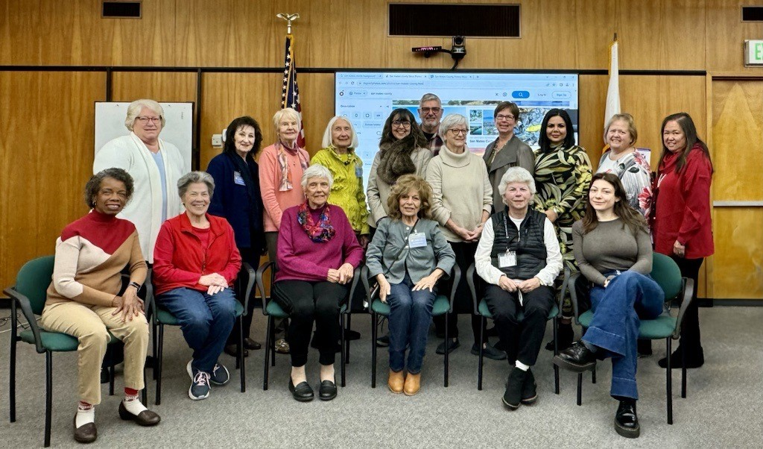

Slide 9
Successful Aging in Place Addressing the Loneliness Crisis
Information
and
Resources
Social Isolation
and
Transportation
Aging Readiness
and
Family Caregiver Support

Slide 10
THANK YOU FOR YOUR SUPPORT OF OLDER ADULTS IN OUR COMMUNITY

