Slide 1
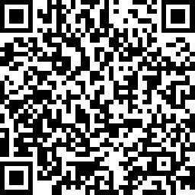
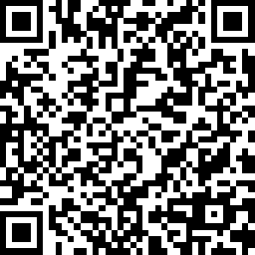
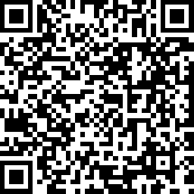
Zoom Housekeeping:
Who is Attending Today?
Please complete demographic survey at:
Spanish | Español surveymonkey.com/r/20200813-SPF-SPA
English surveymonkey.com/r/20200813-SPF-ENG
Chinese | 中文 surveymonkey.com/r/20200813-SPF-CHI

