Slide 1
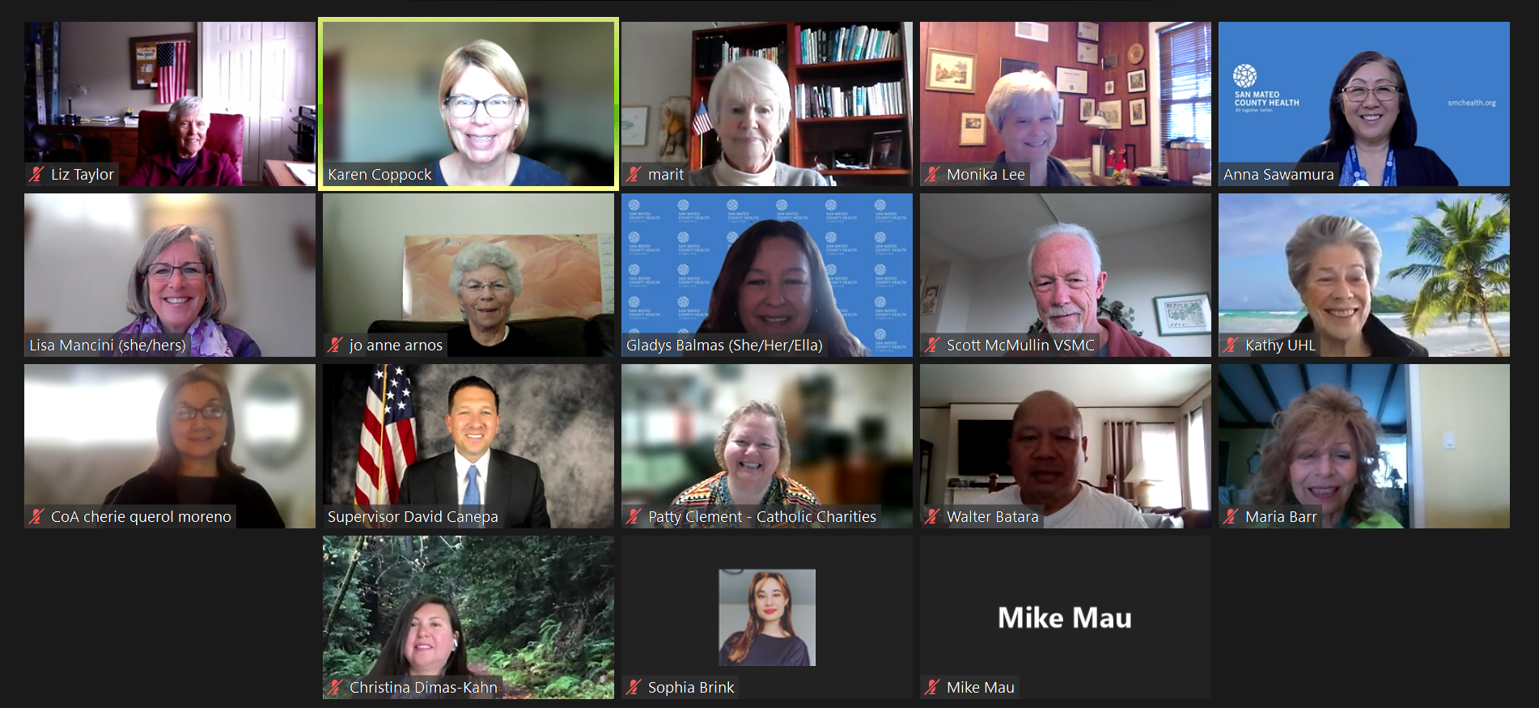

Commission on Aging: Annual Report
May 2022
Commission on Aging
San Mateo County
MAINTAIN – ENHANCE – IMPROVE THE QUALITY OF LIFE
FOR OLDER ADULTS IN SAN MATEO COUNTY

Slide 2
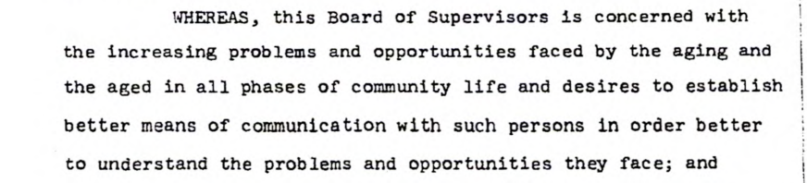
Charter and Committees
  Committees
  Resources, Access & Inclusion Committee
  Transportation
  Middle Income Senior Opportunities

Slide 3
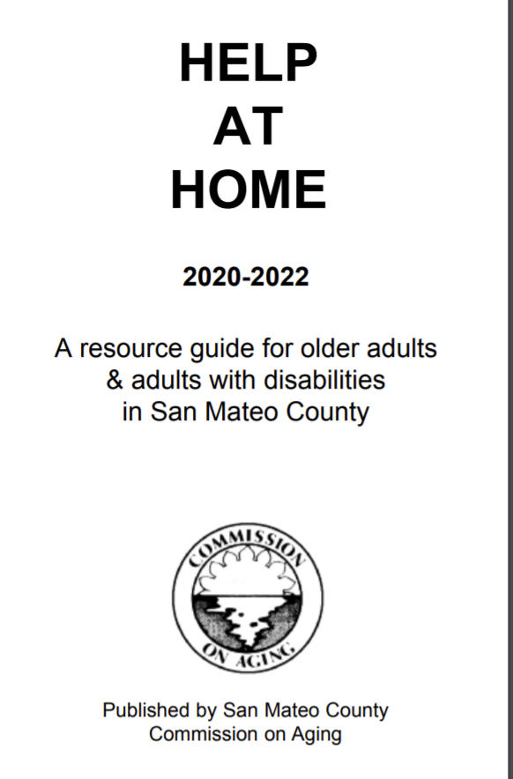


Increasing awareness of critical resources
Community Need: How to access services / benefits?
4,689
older adults reached

Slide 4
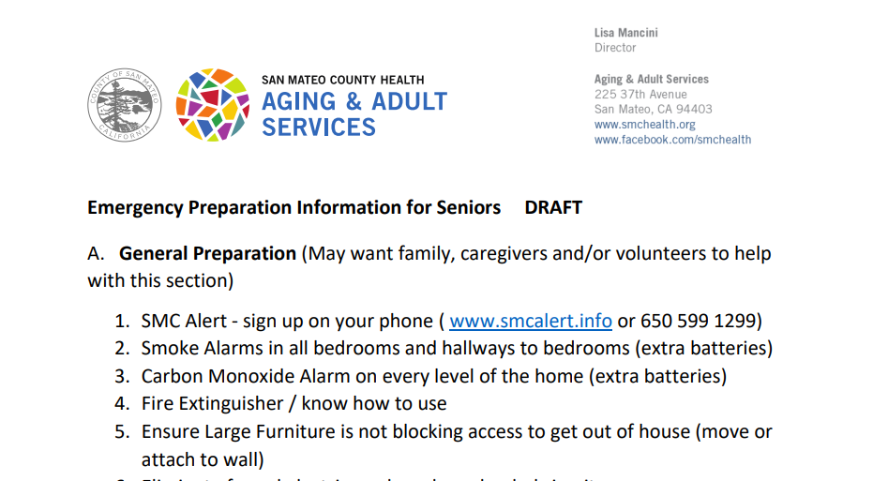
Better preparing older adults for emergencies
Community need: How to better prepare [older adults] for emergencies?
3,000
older adults reached

Slide 5
No one – especially our elders - should go to bed hungry
Community Need: How to feed older adults after the Great Plates Delivered (GPD) Program ends?
$3M
to support an addition
2 years of home delivered meals for 1,000 individuals

Slide 6
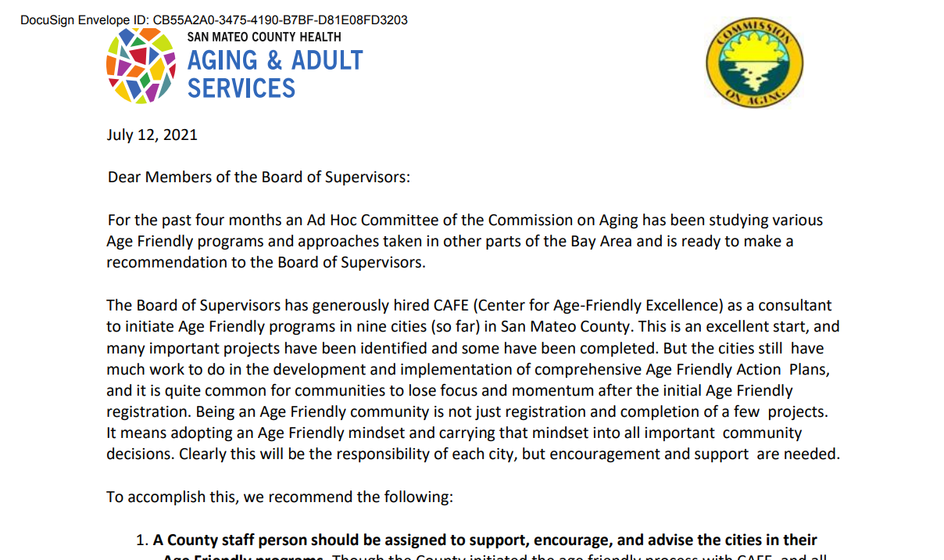
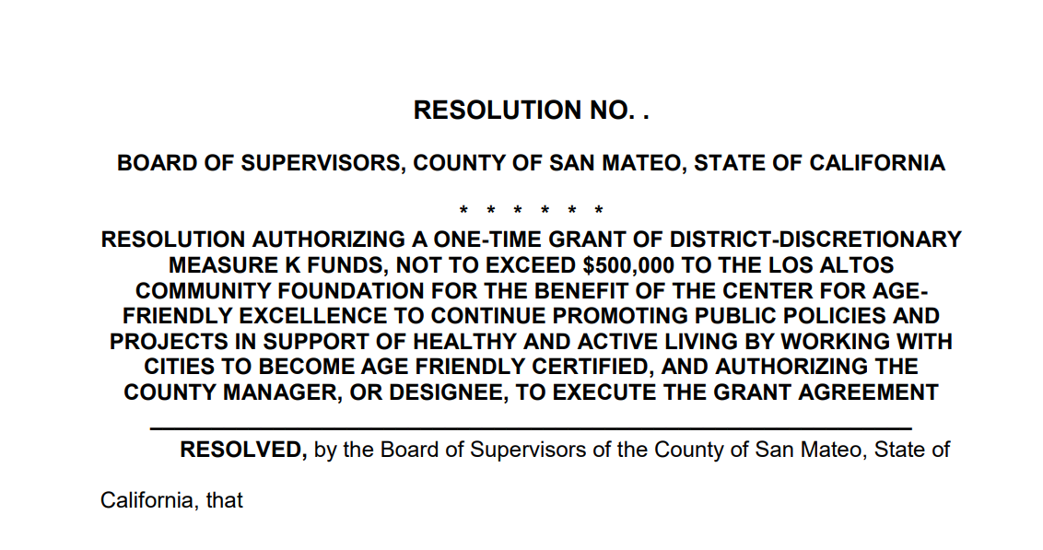
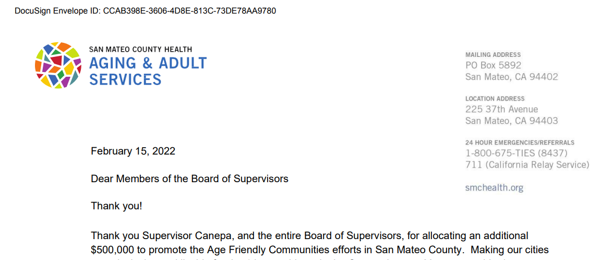
Continuing the momentum on Age-Friendly Cities
Advocacy Goal: secure continued support for Age-Friendly Cities work
$500,000
For Age-Friendly Cities!

Slide 7
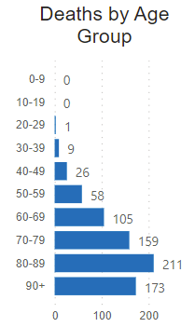
Our Older Adult population – in particular – has suffered from Covid
  17% or 1 in ~6 San Mateo County residents are 65+
  Covid has not been kind to this population:
  Greatest number of deaths
  Missed opportunities with finite time
Cuddling grandkids
Volunteering
Worship
Source: San Mateo County Covid-19 Data Dashboard
https://www.smchealth.org/data-dashboard/county-data-dashboard

Slide 8
Our Older Adult population is growing and is increasingly diverse and older
  Profile of older adults in San Mateo County in 2030:
  1 in 2 will be either Latino or Asian/Pacific Islander
  1 in 2 will be 75 years old or older
1 in 5
San Mateo County
Residents will be 65
years or older by 2030

Slide 9
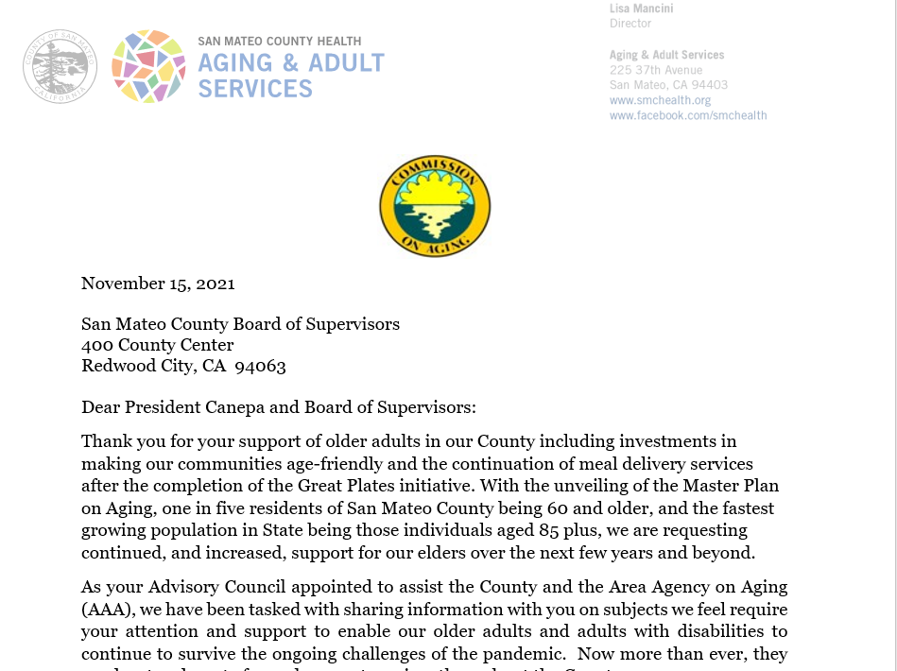
2021 Advocacy Goals & Accomplishments
Advocacy Goal: broad-based support of Older Adults, the fastest growing and most impacted segment by Covid 19.
$2.5M
Case management – connection to critical resources
Bridge the digital divide
Employment opportunities
Reduce isolation/loneliness
Caregiver support (Alzheimer’s)
Expanded homecare eligibility
Guaranteed income pilot test

Slide 10
Thank you for your support of the older adults in our community!

