Slide 1
San Mateo County Commission on Aging Annual Report
May 22, 2018
Presented by Scott McMullin, Chair

Slide 2
Why does the Commission on Aging Exist?
Mandated by the Older Americans Act of 1965 (reauthorized in 2016) and the Older Californians Act
Commissioners are appointed by the Board of Supervisors, to advise the Board and Aging & Adult Services

Slide 3
Our Mission:
To maintain, enhance and improve the quality of life for older adults in San Mateo County through the promotion of independence and self sufficiency, mental and physical health, and social and community involvement.

Slide 4
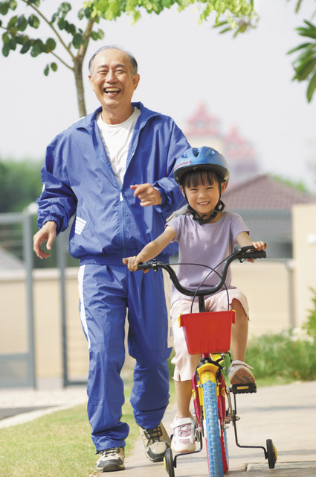
By the year 2030, nearly one out of four San Mateo County residents will be over the age of 65.
San Mateo County Health Policy and Planning Division
San Mateo County Projection Model (2008)

Slide 5
CoA Commissioners
Scott McMullin, Chair
Angela Giannini, 1st Vice-Chair
Bob Giusti, 2nd Vice-Chair
Elsa Agasid
Joanne Arnos
Maria Elena Barr
Walter Batara
Patty Clement Cihak
Karen Coppock
Aurea Cruz
Christina Dimas-Kahn
Jean Hastie
Joan Kilroe
Sandra Lang
Marita Leth
Cherie Querol Moreno
(1 vacancy)

Slide 6
Commission Accomplishments 2017-2018
Areas of accomplishments:
Guest speakers on topics of interest to older adults
Outreach events
Providing resources
Promoting improvements in quality of life
Planning for future Commission work
Notes:
The Commission hosted speakers during the General Meetings on topics of interest identified by the Commission.
CLICK

Slide 7
Guest speakers on topics of interest to older adults
Seniors in Poverty (Elder Index)
Peer Counseling & Pride Center (Pride Month)
Dementia Awareness (Alzheimer’s Research)
Health Plan of San Mateo
Domestic Violence
Affordable Housing Needs
Hospice: Facts & Myths
The Area Plan: Needs and priorities for SMC

Slide 8
Outreach Events
Senior Day at the SMC Fair
Seniors on the Square, RWC (Elder Abuse Awareness Day)
Seniors on the Move
Outreach table at San Carlos Adult Center
Many collaborative presentations with EDAPT (Elder & Dependent Adult Protection Team)
Outreach to faith-based orgs re EDAPT training
Presentation to Youth Commission
Presentation to Commission on the Status of Women

Slide 9
Providing resource material
Developed & distributed flyers for each meeting of the COA, highlighting guest speakers
Informational flyer describing the COA
Continued distribution of flyer on Elder Abuse
Completed the 2018-2020 update of the booklet “Help at Home”

Slide 10
Promoting improvements to the quality of life
Pedestrian Safety: Completed survey of cities on pedestrian safety efforts, and sent letter of concern to the Board of Supervisors and to mayors of all cities surveyed
Blood Draw Needs: Sent letter of concern to Board of Supervisors and major health care corporations regarding lack of blood draw facility on the Coastside
Reviewed and approved the Area Plan for submission to the Board of Supervisors

Slide 11
Planning for future Commission work
Created ad hoc Committee on Middle Income Seniors Issues
Commission retreat in February 2018 to develop a 2-year work plan
Commission approval in May 2018 of the
2-year work plan
Developing additional orientation and training for new commissioners (looking forward to 3 new commissioners after June 2018)

Slide 12
What’s next?
Priority goals in 3 standing committees.
Resource Access
Transportation
Middle Income Seniors Issues
Action items for each goal, with assigned responsibilities and timelines
A renewed commitment to our mission: supporting the goals of the Older Americans Act

Slide 13
Thank you! to the San Mateo County Board of Supervisors
Supervisor David Canepa
Ann Keighran, Legislative Aide

Slide 14
Aging & Adult Services Staff for Commissions and Provider Services
Lisa Mancini, AAS Director
Michelle Makino, Program Services Manager
Andrew Eng, Community Program Analyst II
Lindsey Joyner, Office Specialist
Craig McCulloh, Community Program Analyst II
Cristina Ugaitafa, Community Program Analyst II,
Planner

