Slide 1








Welcome Community Advisory Board Members
Members of the Public
Thank you for being here!

Slide 2
Introductions
Please share:
Name
How long have you been on board
Ice breaker questions (choose one or all)
  Provide one word that describes you and explain why
  What or who inspired you to become active in community work
  Share something that you are grateful for (big or small)

Slide 3
San Mateo County STI/HIV Program
Community Advisory Board Meeting
Tuesday, May 20th, 2025
5:30pm – 7:00pm
Agenda
Facilitators: Anna Branzuela, Clinical Services Manager & Marissa Wagner, Data Management Analyst, STI/HIV and TB Programs
  Welcome & Introductions – All
  Review & Approve of today’s agenda – All
  General Program Updates – Anna
  New Business & Community Updates – All, Facilitated by Anna and Marissa
    HIV Care Connection (HCC)
    Prioritization of HIV Services in San Mateo County – All
  Proposed Agenda Items and Dates for Next Meeting – All
  Adjournment & Thank You

Slide 4
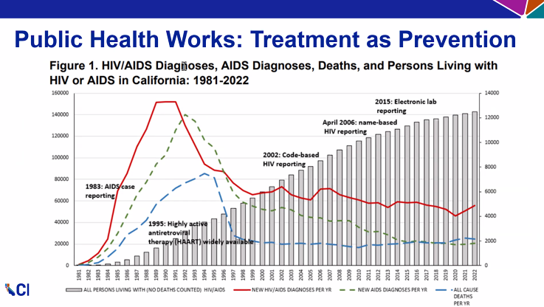
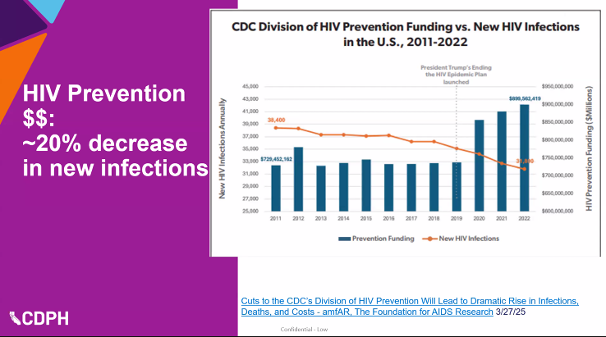
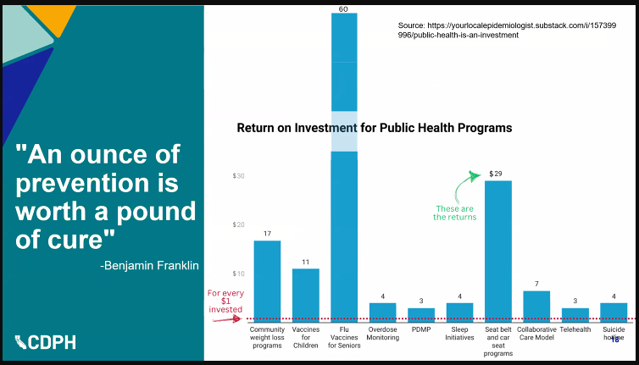
General Program Updates: Public health programs are moving forward in ‘uncertain times’ and focusing on continuing their work. We are also focusing on educating the public on the work we do and how it impacts the community.
Updates from CA STI HIV Controllers Association Conference

Slide 5
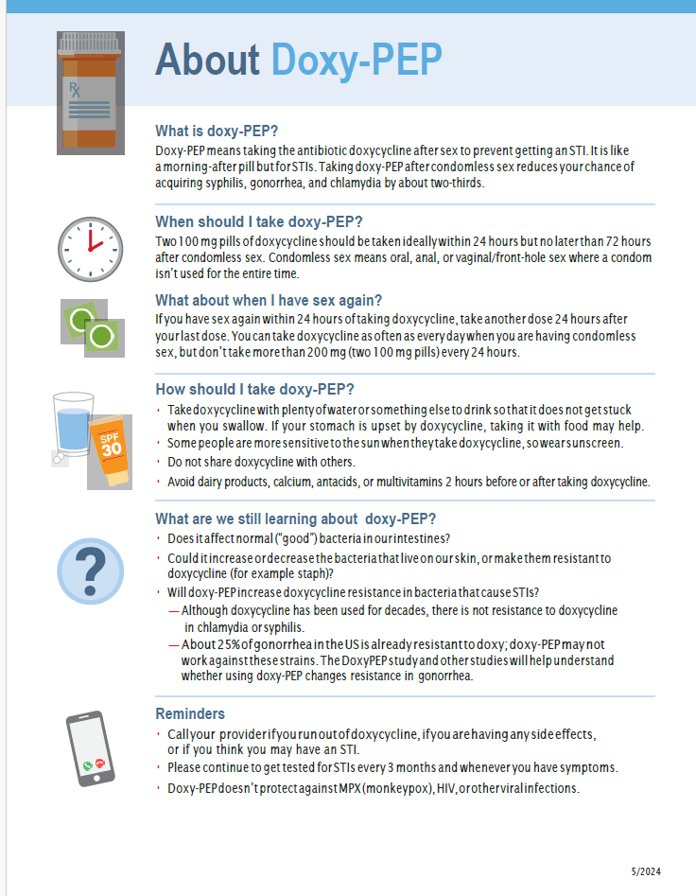
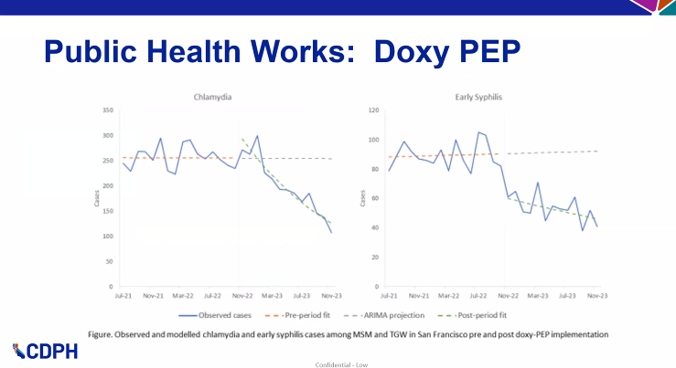
General Program Updates: Public health programs are moving forward in ‘uncertain times’ and focusing on continuing their work. We are also focusing on educating the public on the work we do and how it impacts the community.

Slide 6

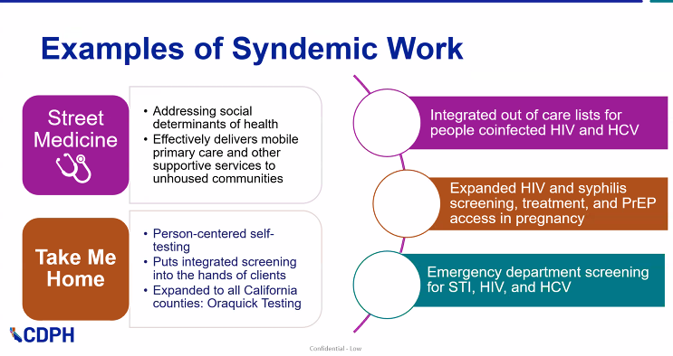
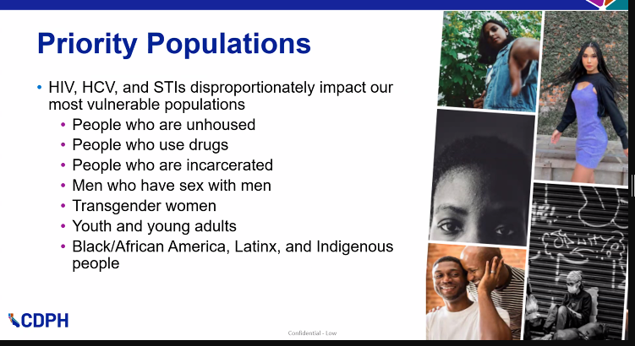
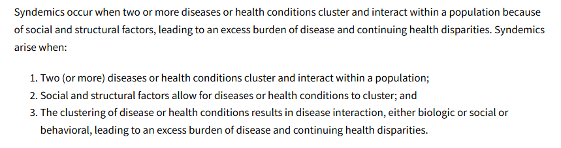
General Program Updates: Public health programs are moving forward in ‘uncertain times’ and focusing on continuing their work. We are also focusing on educating the public on the work we do and how it impacts the community.
Updates from CA STI HIV Controllers Association Conference

Slide 7
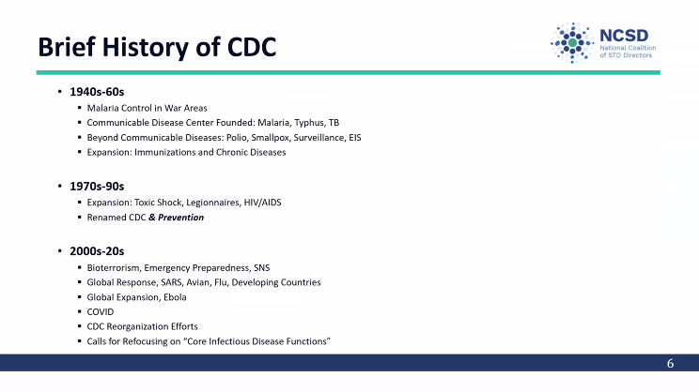

General Program Updates: Public health programs are moving forward in ‘uncertain times’ and focusing on continuing their work. We are also focusing on educating the public on the work we do and how it impacts the community.
Updates from CA STI HIV Controllers Association Conference

Slide 8
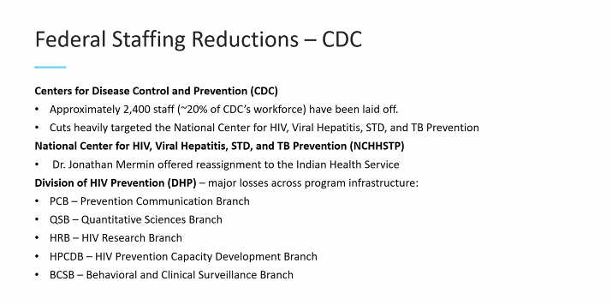
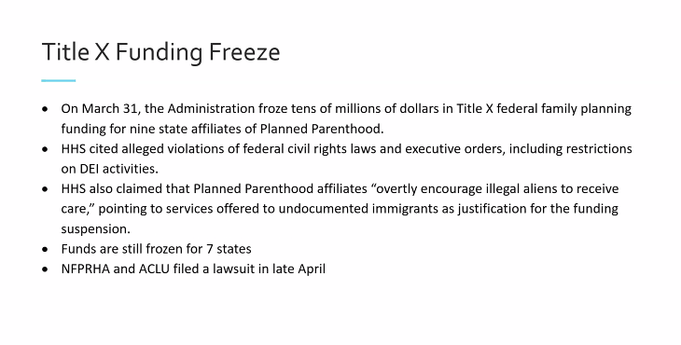
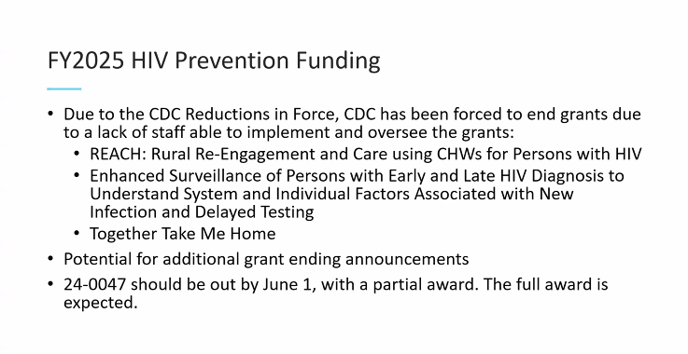

General Program Updates: Public health programs are moving forward in ‘uncertain times’ and focusing on continuing their work. We are also focusing on educating the public on the work we do and how it impacts the community.
Updates from CA STI HIV Controllers Assn Conference

Slide 9

Learn more about the work of public health.
The Invisible Shield, a four-part documentary series, reveals a little-known truth:
that public health saved your life today and you probably don’t even know it.
But while public health makes modern life possible,
the work itself is often underfunded, undervalued, and misunderstood.
https://www.pbs.org/show/the-invisible-shield/

Slide 10
HIV Care Connect (HCC)
CDPH Office of AIDS (OA) developed a new data system called "HIV Care Connect (HCC)" to replace the existing ARIES system.
HCC is designed to provide a more efficient and user-friendly way for providers to connect clients to HIV care, with features like a modern user interface and easier EMR data upload
HCC is designed to improve the efficiency and user experience of connecting individuals with HIV care in California.
HCC went live April 7th

Slide 11
Prioritization of HIV Services
San Mateo County
San Mateo County HIV Program
Community Board Meeting
May 20, 2025

Slide 12
HIV Services Prioritization
Purpose of this process:
  To provide information about HIV services in San Mateo County
  To receive community and board input on the prioritization of Ryan White funded Core and Support services

Slide 13
HIV Services Prioritization
Core Services:
Early Intervention Services: linkage to, and re-engagement in, medical care
Medical Case Management: social workers
Mental Health Services: psychiatrist, therapist, individual and group counseling
Oral Health: dentist, dental services
Outpatient/Ambulatory Health Services: primary care, doctors, nurses, medical treatment, lab tests

Slide 14
HIV Services Prioritization
Support Services:
Emergency Financial Assistance: utilities, unexpected bills, rental assistance
Food Bank/Home-Delivered Meals: bags of groceries, food distribution/delivery, grocery vouchers
Housing Services: emergency housing, motel, short-term rental
Medical Transportation Services: taxi vouchers, samTrans tickets and Redi-Wheels vouchers

Slide 15
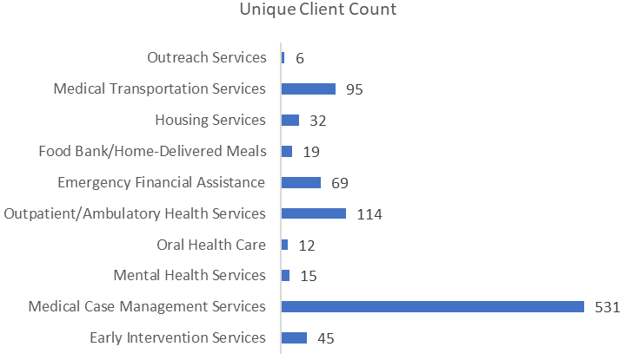
HIV Services Prioritization
Unduplicated Client Count of Ryan White Service Utilization
March 1, 2024 – February 28, 2025

Slide 16
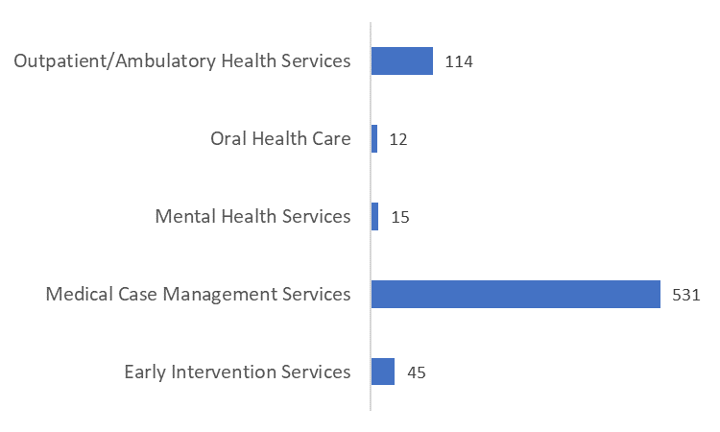
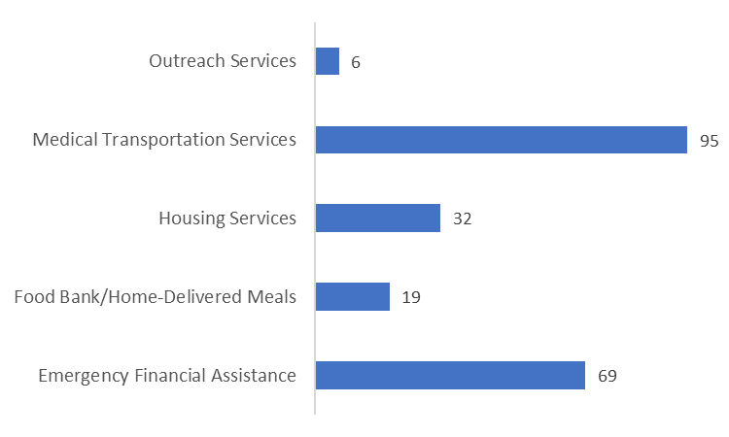
HIV Services Prioritization
Unduplicated client count by Core and Support Services
Core Services
Support Services

Slide 17
HIV Services Prioritization
Results of last year’s prioritization process:
Core Services
1 | Outpatient/Ambulatory Health Services
2 | Medical Case Management
3 | Mental Health Services
4 | Early Intervention Services
5 | Oral Health Services
Support Services
1 | Emergency Financial Assistance
2 | Housing Services
3 | Food Bank/Home Delivered Meals
4 | Medical Transportation Services

Slide 18
HIV Services Prioritization
How do they line up?
Core Services - Prioritization
1 | Outpatient/Ambulatory Health Services
2 | Medical Case Management
3 | Mental Health Services
4 | Early Intervention Services
5 | Oral Health Care
Core Services - Utilization
1 | Medical Case Management (531)
2 | Outpatient/Ambulatory Health Services (114)
3 | Early Intervention Services (45)
4 | Mental Health Services (15)
5 | Oral Health Care (12)

Slide 19
HIV Services Prioritization
How do they line up?
Support Services - Prioritization
1 | Emergency Financial Assistance
2 | Housing Services
3 | Food Bank/Home Delivered Meals
4 | Medical Transportation Services
Support Services - Utilization
1 | Medical Transportation Services (95)
2 | Emergency Financial Assistance (69)
3 | Housing Services (32)
4 | Food Bank/Home Delivered Meals (19)

Slide 20
Ryan White Funding by Category
2023-2024
Core Services
1 | Outpatient/Ambulatory Health Services: $24,132
2 | Medical Case Management: $575,631
3 | Oral Health Care: $75,000
4 | Mental Health Services: $125,792
5 | Early Intervention Services: $152,770
Support Services
1 | Housing Services: $20,000
2 | Emergency Financial Assistance: $105,000
3 | Medical Transportation Services: $27,500*
4 | Food Bank/Home-Delivered Meals: $364,000
* Funded with Ryan White Part B

Slide 21
Ryan White Funding by Category
2024-2025
Core Services
1 | Outpatient/Ambulatory Health Services: $66,970
2 | Medical Case Management: $616,412
3 | Oral Health Care: $75,000
4 | Mental Health Services: $30,205
5 | Early Intervention Services: $164,400
Support Services
1 | Housing Services: $20,000
2 | Emergency Financial Assistance: $112,500
3 | Medical Transportation Services: $27,500*
4 | Food Bank/Home-Delivered Meals: $400,000
Medical Transportation solely funded with Ryan White Part B, and Outpatient Ambulatory partially funded with Ryan White Part B ($300k)

Slide 22
Ryan White Funding by Category
2025-2026*
*final numbers pending award
Core Services
1 | Outpatient/Ambulatory Health Services: $23,794
2 | Medical Case Management: $575,631
3 | Oral Health Care: $75,000
4 | Mental Health Services: $125,792
5 | Early Intervention Services: $152,770
Support Services
1 | Housing Services: $20,000
2 | Emergency Financial Assistance: $112,500
3 | Medical Transportation Services: $27,500*
4 | Food Bank/Home-Delivered Meals: $400,000
* Funded with Ryan White Part B

Slide 23
Ryan White Funding History
Decrease in Ryan White Part A of $566,153 (27.60%) since 2011-2012
    2011-2012: $2,051,640
    2012-2013: $1,641,628
    2013-2014: $1,358,915
    2014-2015: $1,183,453
    2015-2016: $1,183,460
    2016-2017: $1,179,267
    2017-2018: $1,176,303
    2018-2019: $1,143,218
    2019-2020: $1,267,929
    2020-2021: $1,375,312
    2021-2022: $1,362,815
    2022-2023: $1,442,325
    2023-2024: $1,442,325
    2024-2025: $1,485,487
    2025-2026:

Slide 24
Prioritization - All
Support Services - Prioritization
Emergency Financial Assistance
Housing Services
Food Bank/Home Delivered Meals
Medical Transportation Services
Support Services - Prioritization
Emergency Financial Assistance
Housing Services
Food Bank/Home Delivered Meals
Medical Transportation Services

Slide 25
Proposed Agenda Items and Dates for Next Meeting – All
Dates
  Sept
    Proposed Sept 2, Tuesday
  Dec
    Propose Dec 2, Tuesday
What areas of focus you would like updates on from public health?
Other agenda items you want to add
Food selection

Slide 26


