Slide 1

BHRS Specialty Mental Health Private Provider Orientation
Presented by:
Laura Smith, lmft, Provider relations coordinator & Jayme Berja, patient services specialist

Slide 2


AGENDA
Welcome
Introductions
Overview
BHRS Youth Clinics & Programs
BHRS Adult Clinic & Services
Referral Process
Clinical Team Meetings
Team Approach & What to expect
Information for SPPN Clients
Clinical Documentation Requirements
Progress Notes
Required Trainings
Other Important Information
Claims Submission - Jayme
Questions

Slide 3
Overview
Specialty mental health services are those that are provided to the Seriously Mentally Ill (SMI) and Seriously Emotionally Disturbed (SED) populations.
There are approximately130 BHRS clients open to the SPPN for therapy.
Most SMI and SED clients are open to a BHRS clinic and have a treatment team.
At times, the clinic may need to refer a client to the SPPN for therapy if they don’t have capacity within, or if there’s a specific request or specialty being recommended.

Slide 4
BHRS Youth Clinics & Programs
5 Outpatient Regional Clinics
  North County - Daly City
  Central County - San Mateo
  South County - Redwood City
  Coastside Clinic – Half Moon Bay
  East Palo Alto Community Counseling Center – East Palo Alto
Other Youth Programs (e.g. YCM, Child Welfare, Prenatal to 5, Youth to Adult Transition)
Things to Consider
  Referrals will primarily be for adjunctive services (e.g. specialized services)
  Youth referrals for therapy will be made less frequently
  Collaboration with SPPN provider might require more frequent communication with Care Coordinator (e.g. Therapeutic Behavioral Services)

Slide 5
BHRS Adult Clinics & Services
Five Adult Outpatient Regional Mental Health Clinic Monday – Friday 8 - 5
  North, South, Central, East Palo Alto, Coastside
Services Provided
  Psychiatry, Case Management, Nursing, Individual therapy, Group therapy
Multidisciplinary team
  Care coordinator, Nurse, MD
Access refers Clients for regional services (walk-in)
  SDA Assessment Process to Evaluate appropriate level of care M2M and SMI
Care Coordinator completes Assessment, Tx plan, and assesses for treatment readiness.
  Clinic refers client to Access for therapy services

Slide 6
Referral Process
When a client is referred to the SPPN, it is for therapy only.
An assessment and treatment plan have been developed.
When a new client is referred, you will be contacted by Access with the client’s demographic and clinical information.
  (If you’re unable to accept the referral for any reason, it’s expected that you call Access within 24 hours of referral.)
Your information will be shared with the client’s BHRS Care Coordinator (CC), who will connect with you to schedule a Clinical Team Meeting.
The CC will send you a copy of the current assessment and treatment plan, prior to the first Clinical Team Meeting.

Slide 7
Clinical Team Meeting
Initial Clinical Team Meeting
Follow up Clinical Team Meetings
Discharging client

Slide 8
Team Approach &What to Expect
Referring back to case manager when clients are experiencing elevated psycho-social stressors.
Officer of the Day Support vs Emergency Services if appropriate.
Collaborating with client’s treatment team. SPPN provider viewed as extension of clinic treatment team.
Communicate challenges with engagement or participation.
Continuation of services.

Slide 9
Information for SPPN Clients
SPPN Provider will communicate regularly with BHRS Treatment Team
SPPN therapy is time-limited and solution focused. Frequency of appointments is based on treatment plan and therapy goals.
Clients are expected to participate in Annual Treatment Plan Team Meeting
Attend all appointments.

Slide 10
Clinical Documentation Requirements
Signed client consent
Signed copy of Notice of Privacy Practices/HIPAA
Signed Release of Information, if applicable
A signed and dated progress note for every service that is billed
Closing Summary
All documentation should be typed
Progress note and closing summary templates available at: https://www.smchealth.org/bhrs/contracts

Slide 11
Progress Notes
Each progress note must be standalone,
Client Name and BHRS Medical Record Number
Date of Service
CPT Code
Location Code (this can be found at the bottom of the template)
Diagnosis addressed
Provider and Agency Name, if applicable
Face to Face minutes (client present) – claimed minutes
Service time (client not present)
Language (if language services were provided)
Service Description: Goal/behavior addressed, therapist interventions, client’s response/outcome, and plan.
Signature, printed name, credentials, and date

Slide 12
Required Trainings
All BHRS trainings can be found on the Learning Management System (LMS)
New BHRS Contractor Compliance Bundle”
  Compliance Training for BHRS
  Confidentiality & HIPAA for Mental Health and AOD
  Fraud, Waste, and Abuse
  Critical Incident Reporting
Cultural Humility
Working Effectively with Interpreters
Sexual Orientation Gender Identity training (SOGI)

Slide 13
Other Important Information
Protected Health Information (PHI)
Change of provider requests
Length of Tx plan will vary
Critical incident reporting (unusual events, accidents, errors, violence or significant injuries)

Slide 14

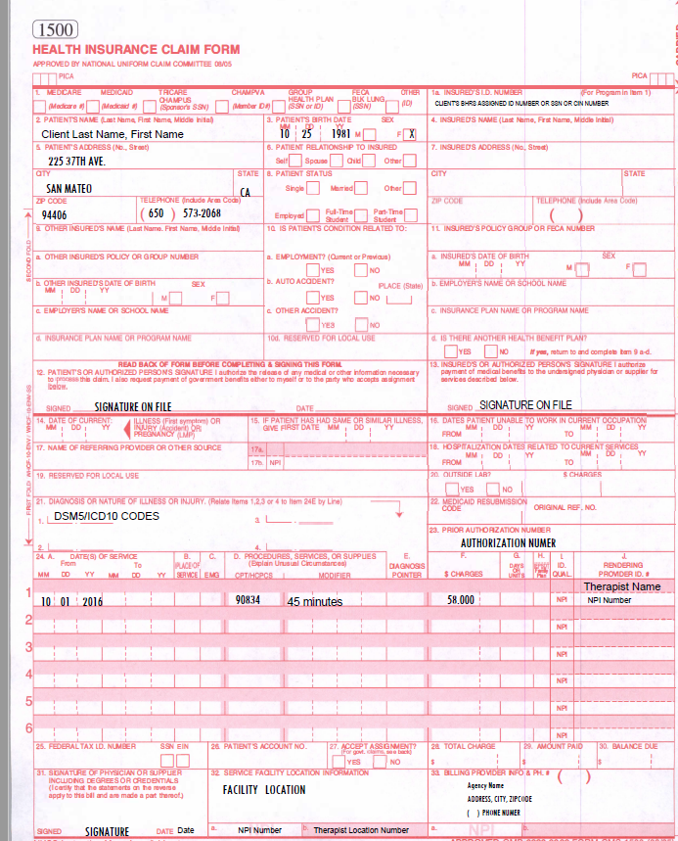


Claims Submission

Slide 15
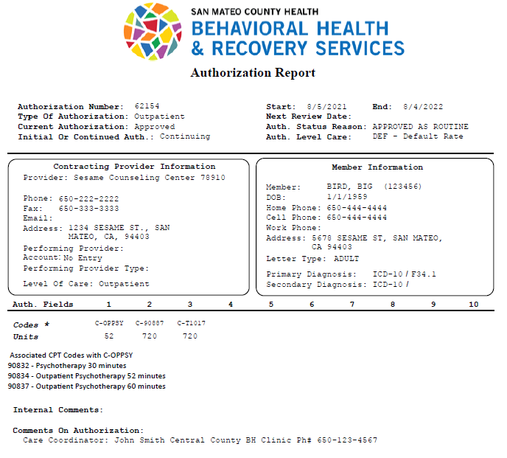
Sample Payment Authorization

Slide 16

Questions

