Slide 1


Slide 2



Welcome to the
2021 Mental Health Month Kickoff
Saturday, May 1
10am-11am
**Interpretation available in Spanish, Mandarin, Tagalog, Tongan and Samoan.
**This event is being RECORDED.
Notes:
WHAT IS MHM?
San Mateo County joins our state and country in celebrating Mental Health Month (MHM) in May.
Lime green is the national color for mental health and represents how we want to bring a bright light to an important issue that may be hidden or seen negatively

Slide 3
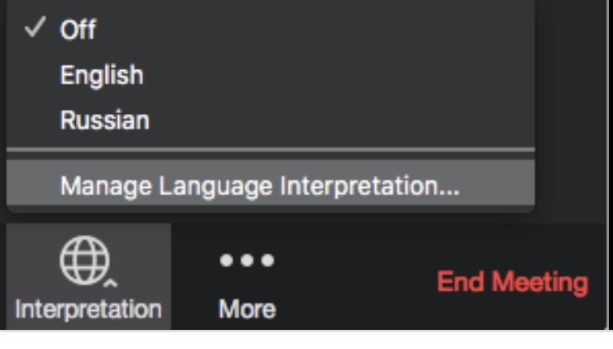
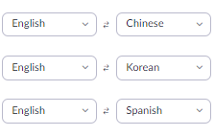
Everyone: Please Choose a Language
On Computer: Please click the small globe icon at the bottom of your screen and choose your preferred language.
On Phone (App): Click “more” button to switch languages.
Please speak clearly, not too fast and be mindful of acronyms
Notes:
INTERPRETATION/TRANSLATION
No interpretation if joining by phone only
We may not have staff to translate non-English comments in all other languages
Por Computadora: Si necesita servicios de interpretación, haga clic en el botón pequeño del mundo en el centro y parte inferior de su pantalla y elija el idioma de interpretación que necesita.
Por Telefono: haga clic en “mas” para cambiar idioma

Slide 4
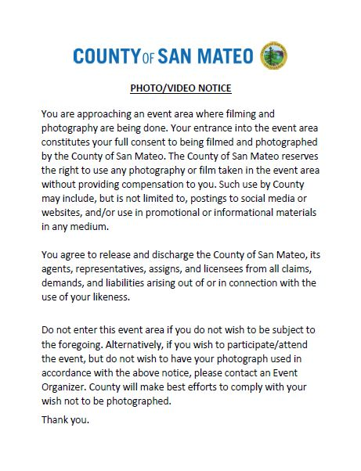
This Event is Being RECORDED

Slide 5

Zoom Housekeeping:
Zoom Housekeeping
Participants will be muted
To be unmuted during the input section:
  Use “Raise Hand” button
  Use “Thumbs up” button (phone app)
  2 mins. maximum per participant
There will be specific times held for those joining by phone to make comments
Please use Q & A feature for questions and chat for comments
We will take feedback via email and phone after the meeting
The presentation slides and recording will posted on our website (link provided at the end)
Please understand that there may be unexpected technical difficulties

Slide 6
Zoom Housekeeping:
Event Overview
Opening Remarks (10 minutes)
Cooking Demo (10 minutes)
Nature Meditation (15 minutes)
Closing Remarks (5 minutes)

Slide 7
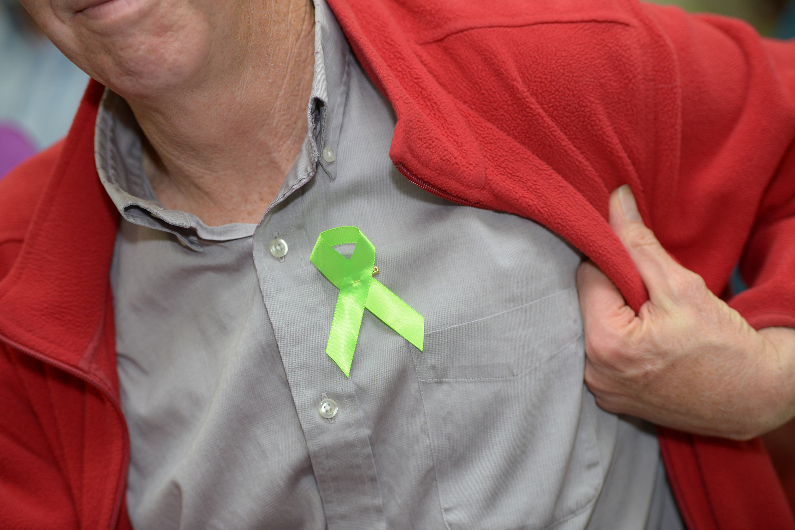

Why Recognize MHM?
Notes:
WHY MHM?
Mental health and substance use conditions affects 1 in 4 adults in the US in 2019; estimates suggest that one in four adults with a mental health condition are not receiving the help they need; and
Communities have faced increasing mental health challenges related to the COVID-19 pandemic. The percentage of adults who had symptoms of an anxiety or a depressive disorder and those with unmet mental health needs increased significantly (from 36.4% to 41.5% and 9.2% to 11.7% respectively) during August 2020 to February 2021
Stigma and lack of awareness of resources are some of the key barriers preventing people from getting help around mental health and substance use issues

Slide 8
One-Third SMC Respondents Reported Having Had a Mental Health Problem
36%
Have Had Mental Health Problem
Among those who have had a mental health problem, almost three-quarters have sought treatment
72%
Sought Treatment for Mental Health Problem
Source: 2020 San Mateo County Stigma Baseline Survey by Strata Research

Slide 9
One in Ten SMC Respondents Reported Having Had a Substance Use Problem
13%
Have Had Substance Use Problem
Among those who have had a substance use problem, more than half have sought treatment
55%
Sought Treatment for Substance Use Problem
Source: 2020 San Mateo County Stigma Baseline Survey by Strata Research

Slide 10

smchealth.org/MHM
Notes:
EVENTS CALENDAR AND MINI-GRANTS
2021 MHM Theme: #HopeForChange
This year’s theme, aligned with the statewide theme, is #HopeForChange.
#HopeForChange reminds us to spread and rely on the hope that carried us through a year of change.
2021 MHM Virtual Events
San Mateo County MHM Planning Committee and partners have organized almost 50 virtual events that feature open mic, music, art, films, pets, children stories, speaker panels and more!
Events will target a range of age groups and will be largely be in English and Spanish (while some events are in additional languages)
All events are free and open to the public but space but is limited; please register to save your spot
2021 MHM Proclamations
County Proclamation
City Proclamations – 19 out of 20 cities in San Mateo County

Slide 11
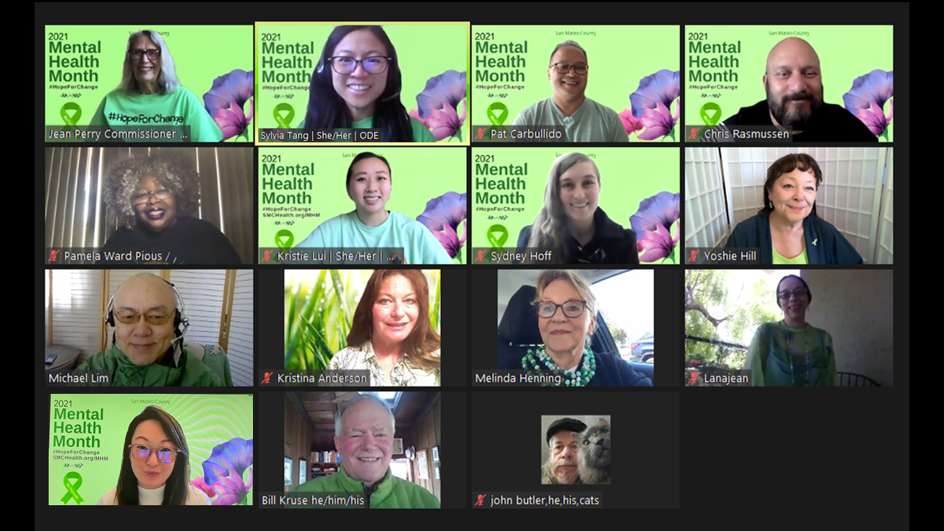
MHAM Planning Committee
Notes:
CALL TO ACTION (1 MINUTE)
Attend and share one or more MHM event (promo flyer on next page)
Wear lime green or something green
Talk openly about mental health with others

Slide 12
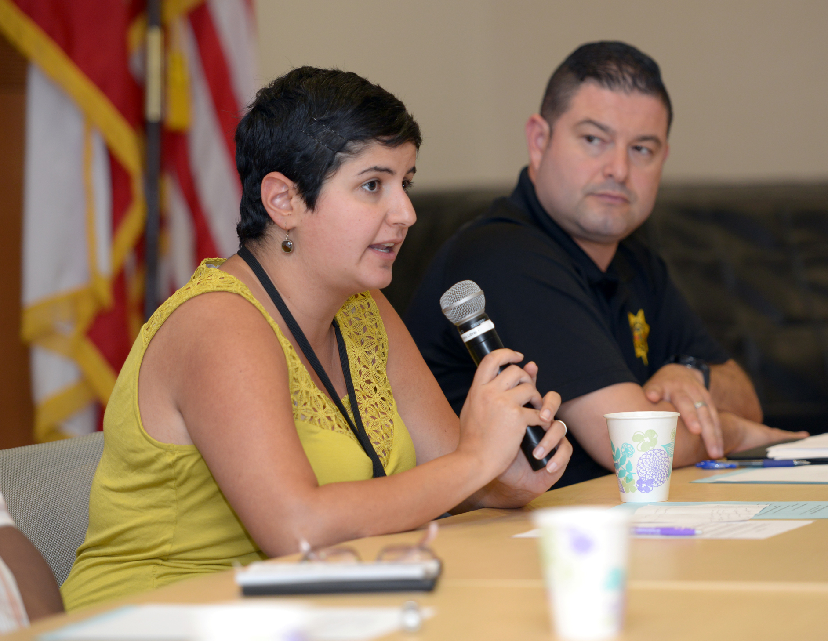
Questions?
Notes:
Q&A GUIDELINES
To be unmuted during the input section:
Use “Raise Hand” button
Use “Thumbs up” button (phone app)
2 mins. maximum per participant
There will be specific times held for those joining by phone to make comments
Please ask questions by Q & A feature
We will take feedback via chat, email and phone after the meeting

Slide 13
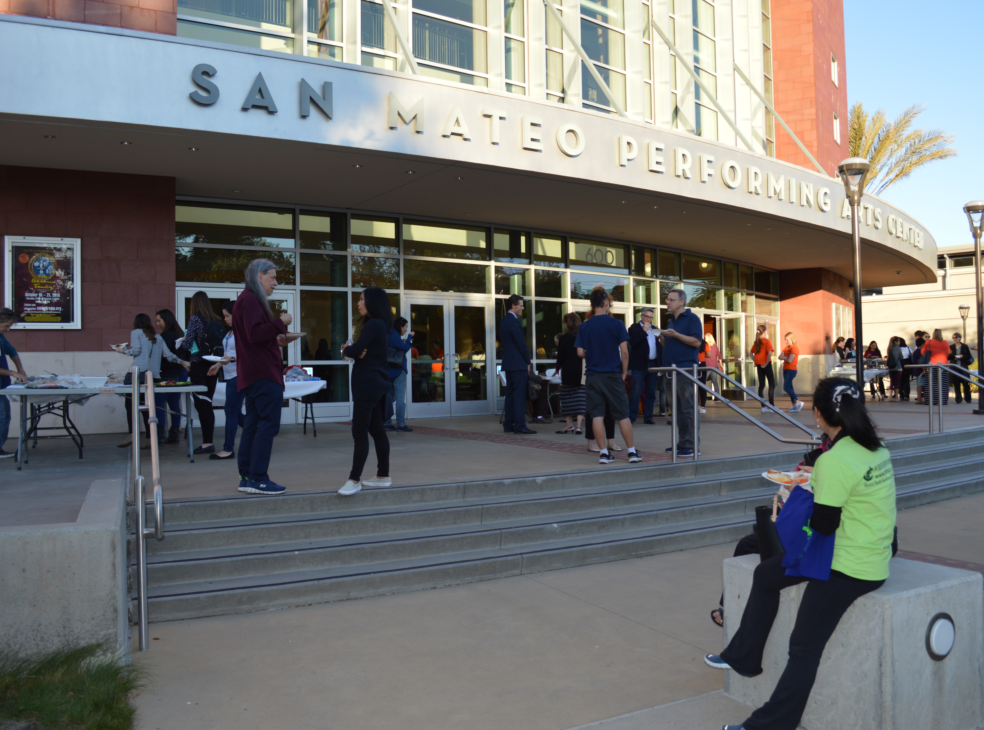
3. Next Steps

Slide 14
Behavioral Health Resources
for mental health and substance use services
NON-EMERGENCY
Access Call Center
mental health and substance use services
800-686-0101
TDD: 800-943-2833 or 711
COVID-19 Mental Health Resources
smchealth.org/covid-19-mental-health
EMERGENCY (24/7)
Call 9-1-1 for medical or psychiatric emergencies (if you can’t call, text 911)
Crisis Hotlines
650-579-0350 or 800-273-8255 (TALK)
Text “BAY” to 741741
Notes:
(15 SECONDS)

Slide 15
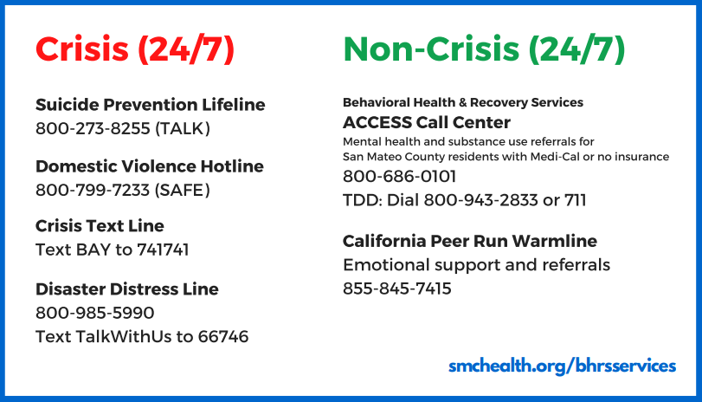
Behavioral Health Resources
Download at smchealth.org/covid-19-mental-health

Slide 16
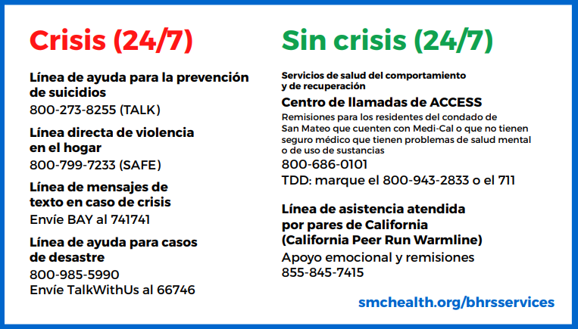
Resources
Download at smchealth.org/covid-19-mental-health

Slide 17
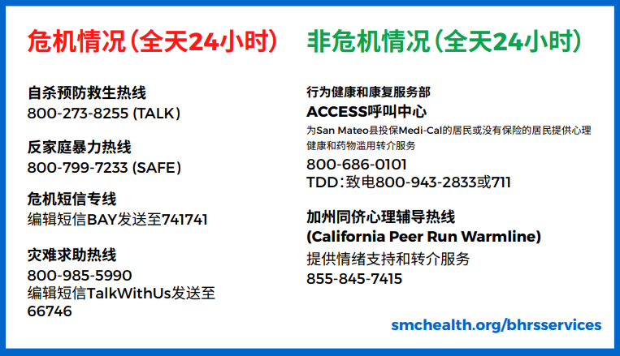
Resources
Download at smchealth.org/covid-19-mental-health

Slide 18

smchealth.org/MHM
stang@smcgov.org or kflui@smcgov.org
650-578-7165
Notes:
(5 SECONDS)

Slide 19
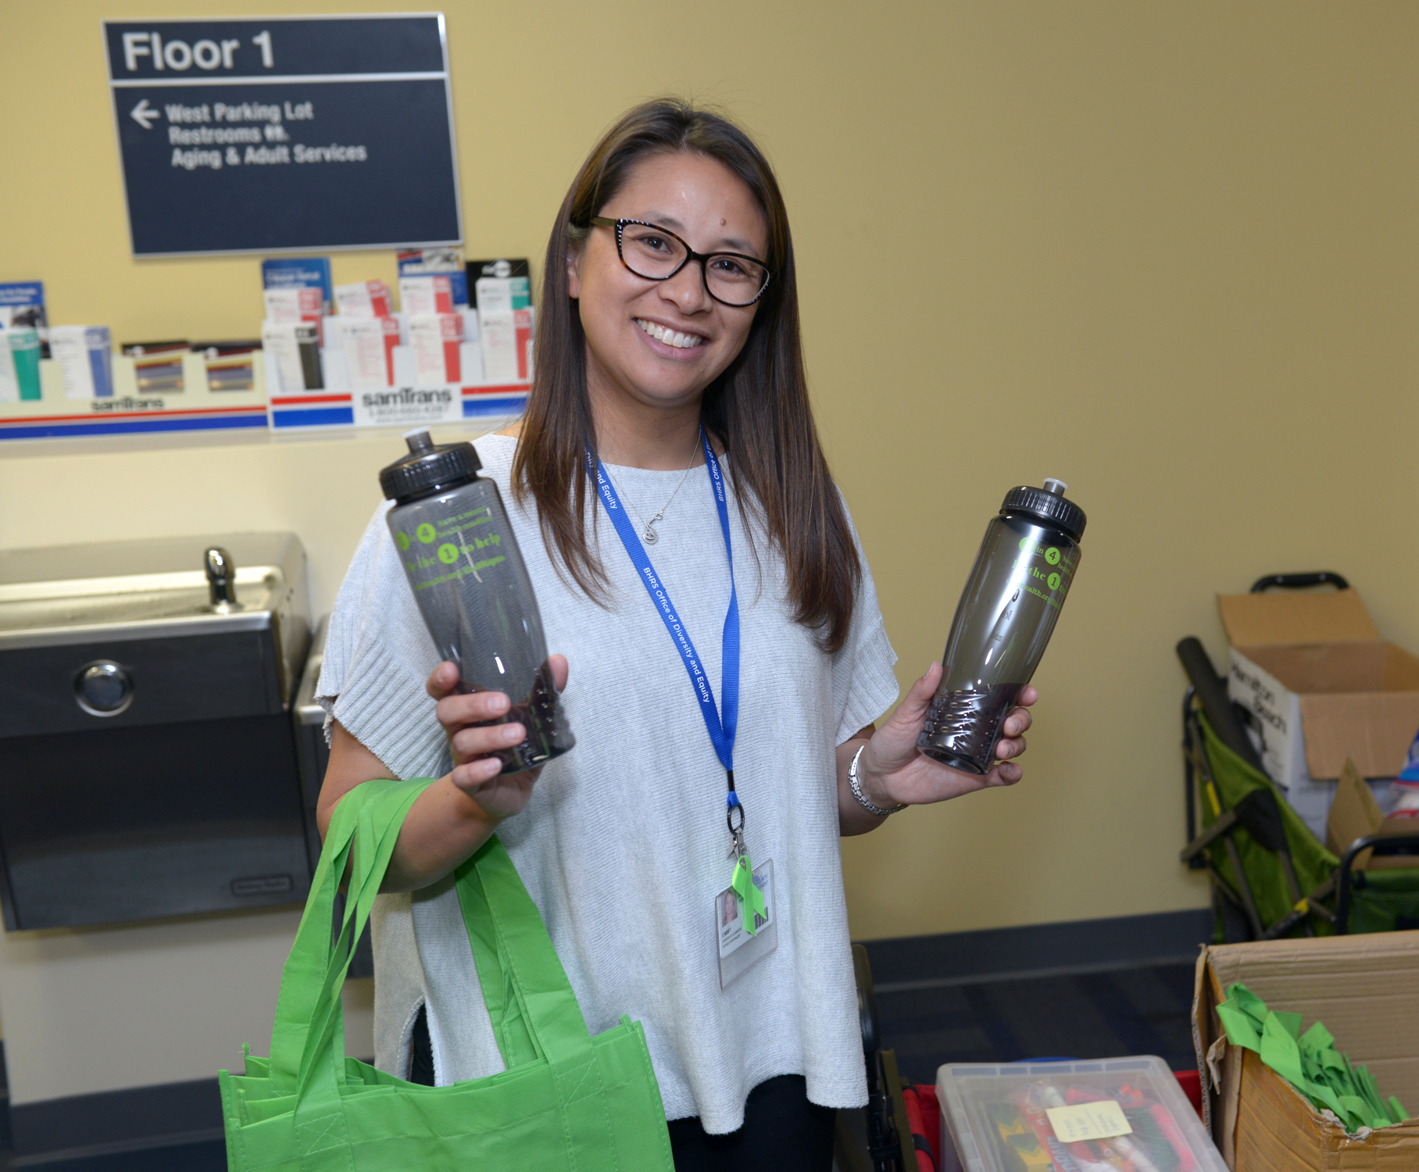
Thank You!

Slide 20
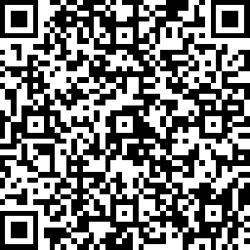
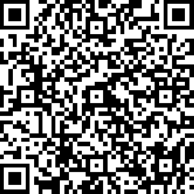
Zoom Housekeeping:
Please Complete by Today
5/1/2021 | Mental Health Month Kickoff
surveymonkey.com/r/20210501-Kickoff-Demog
surveymonkey.com/r/20210501-Kickoff-Eval

